Slide 1
The Byzantine Empire
Global History and Geography I
Mr. Cox

Slide 2
Bellringer
Review: What were the causes of the collapse of the Roman Empire?
Essential Question
Why was the Byzantine Empire historically significant?

Slide 3
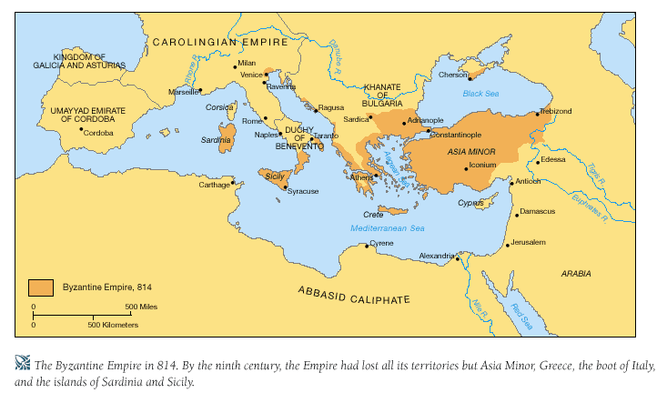
I. East Europe After Rome
Constantine had moved the capital to Constantinople
Blending of cultures
Roman/Greek
Christian
Middle Eastern/Muslim
Center of trade and cultural diffusion
(In between Asia and Europe)
Eastern Roman Empire lived on as the Byzantine Empire
490-1453 CE

Slide 4
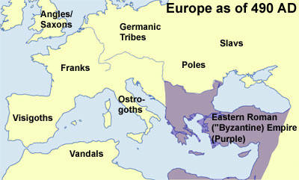

Slide 5
II. Religion
Faith split in two
Roman Catholics (West Europe)
Orthodox Christians (East Europe)
Emperor controlled Church affairs
Began to question the Pope’s authority
Appointed a patriarch: high ranking Church official
Worship of icons: depictions of religious figures

Slide 6
Quickwrite
What are the two sects of Christianity at this point in history? Where is each primarily located?

Slide 7
III. Achievements
Endured as a symbol of Roman civilization
Many great and informative literary works
Recorded history, preserved Greco-Roman culture and ideals
New styles of religious architecture
Blended Roman with Middle-Eastern (Muslim)

Slide 8
III. Achievements Cont’d
Spread culture to Russia, including Cyrillic alphabet and Orthodox Christianity
Connected East Asia w/ Western Europe through the Silk Road trade route

Slide 9
IV. Causes for Decline
Internal power struggles
Lack of competent leaders after Justinian
Outside attacks
Crusades
Seljuk Turks in 1453 led to the rise of the Ottoman Empire

Slide 10
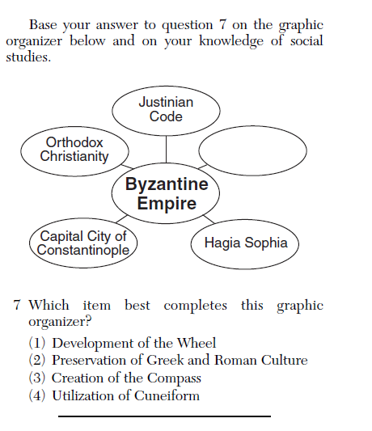

Slide 11
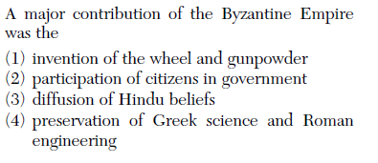

Slide 12
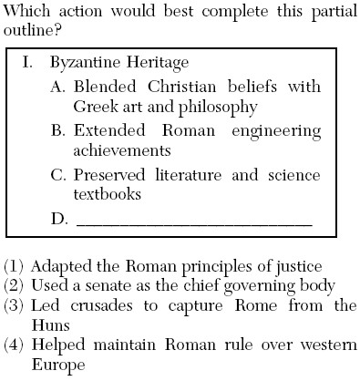

Slide 13
Essential Question
Why was the Byzantine Empire historically significant?

