Slide 1
The Qin Dynasty
Global History and Geography I
Mr. Cox

Slide 2
Bellringer
What was one major contribution of the Shang and Zhou Dynasties? Look back in your notes if you need to.
Essential Question
What was the importance of Shi Huangdi to the Qin Dynasty?

Slide 3
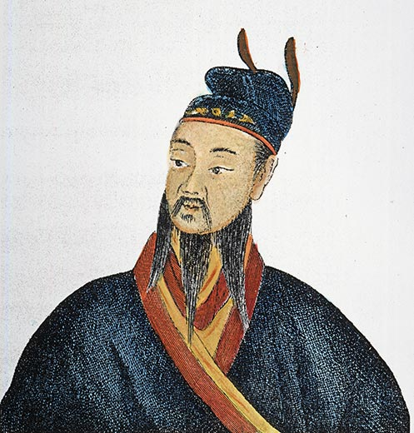
I. Shi Huangdi
“First Emperor”
Warring Zhou lord who united the feudal lords
Centralized power, used legal advisers.
Qin Dynasty
Merit based rewards
Punishments for failure
Authoritarian government

Slide 4
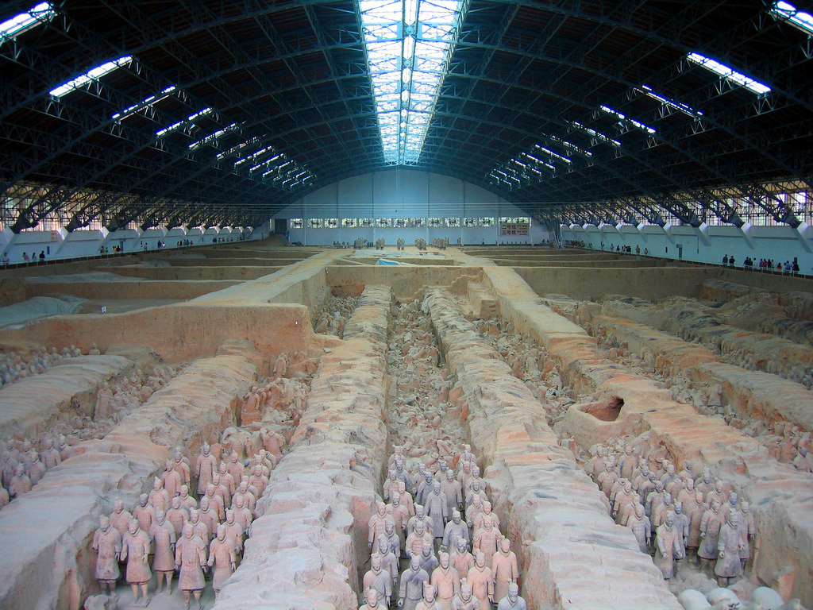

Slide 5
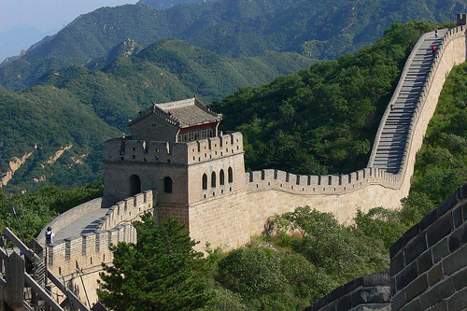
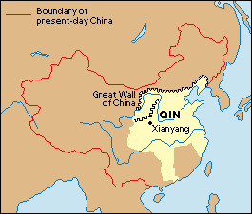
II. Qin Dynasty
Abolished feudalism, set up 36 military districts
Monitored Nobles
Very heavy taxes on peasants to support army and Great Wall
Killed any who were suspected of opposing him
Burned books of literature and philosophy

Slide 6
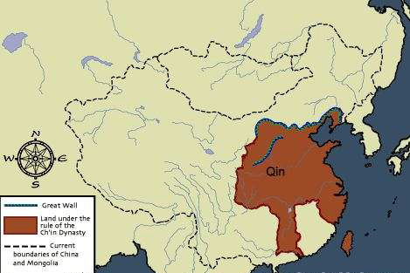
III. Collapse of the Qin
Shi Huangdi died in 210 BC
Collapsed after his death
Heavy taxes
Forced Labor
Cruel Policies
Revolts against government
http://www.youtube.com/watch?v=RsUE-ZtcUFg

Slide 7
Essential Question
What was the importance of Shi Huangdi to the Qin Dynasty?

Slide 8
Engineering an Empire: China
Global History and Geography I
Mr. Cox

Slide 9
Engineering an Empire: China
As you watch the video, take notes on the great engineering feats of China:
Great Wall
Terra Cotta Warriors in Shi Huangdi’s Tomb
Grand Canal
You will be required to summarize this video as a homework assignment. (15 pts.)
http://www.youtube.com/watch?v=I9evCYVir5k

