Slide 1
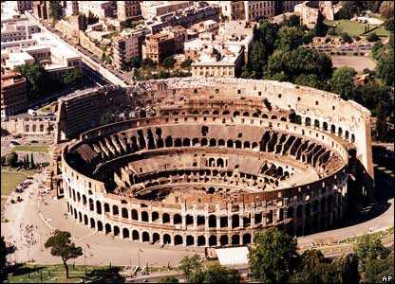
Roman Society and Culture
Global History and Geography I
Mr. Cox

Slide 2
Bellringer
Review: define the terms culture and infrastructure.
Essential Question
What are the characteristics of ancient Roman culture?

Slide 3
I. Breaking the Mold
Very different from other ancient civilizations
Women had a larger role and social standing
Education was much more widespread, even for the poor
Citizens were much more active in government, no strong central ruler in the Republic

Slide 4
Polytheistic: many gods
Similar to Greece
Expansion and war
Legion: basic Roman military unit
Soldiers were an occupation for citizens to hold
Conquered the Italian peninsula and surrounding territories

Slide 5
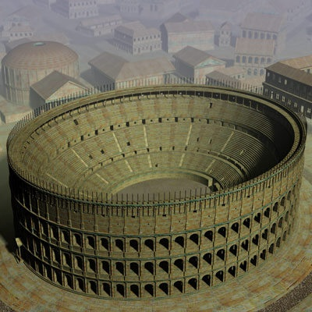
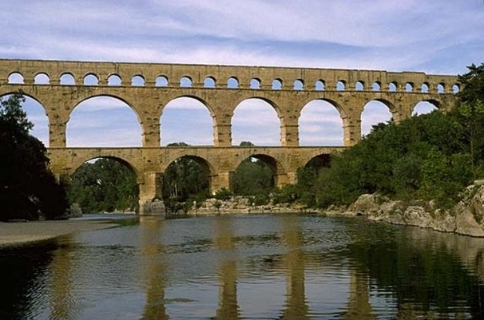
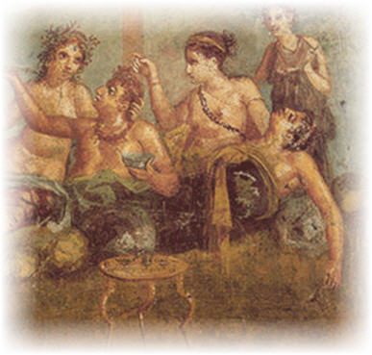
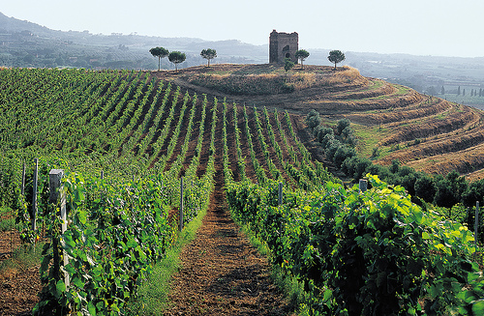
III. Roman Culture
The City of Rome: Culturally rich
Wine: common in all aspects of life
Architecture: large palaces and temples: Colosseum
Mosaics: picture made from chips of colored glass
Engineering: application of math/science to development of structures and machines
Aqueducts: structures that brought water to Rome
http://www.youtube.com/watch?v=YYupXlYZGMs

Slide 6
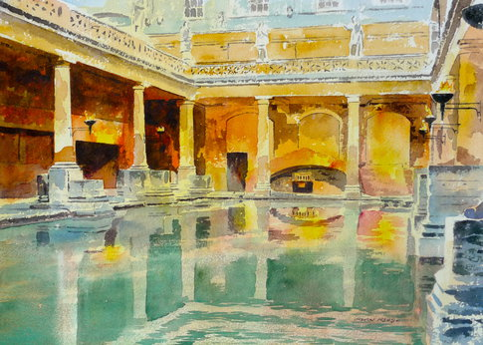
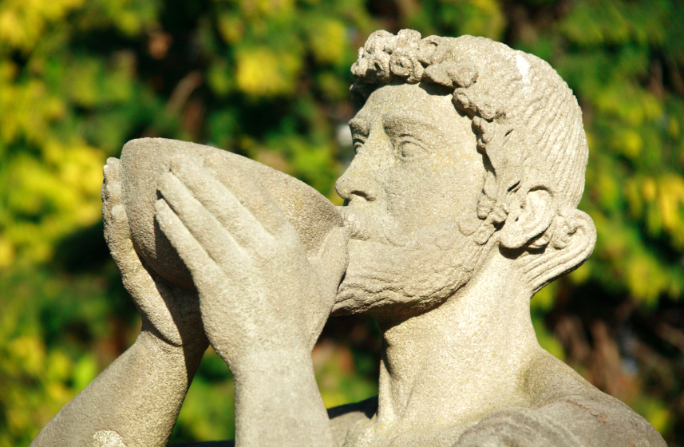
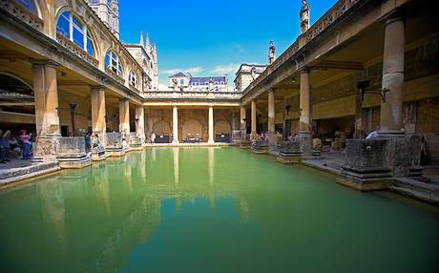
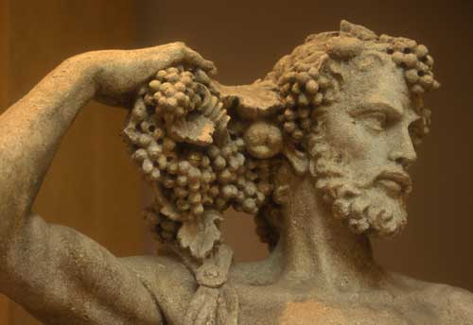
Baths Wine

Slide 7
Essential Question
What are the characteristics of ancient Roman culture?
Homework

