Slide 1
Growth of Royal Power in England
Global History and Geography I
Mr. Cox

Slide 2
Bellringer
Review: define the term monarchy.
Essential Question
How did the Magna Carta and Parliament impact the English Monarchy?

Slide 3
I. Monarchs in Feudal Society
Supreme ruler of a country, but had little direct power
Lords and the Church had power, serfs were loyal to them
Held court
Collected taxes
Had own armies
A series of strong rulers in England would change this and expand the power of the monarchy.

Slide 4
Quickwrite
Why was power in the hands of the nobles and church during the middle ages?

Slide 5
II. Evolution of English Government
1066 CE Norman Conquest | 1086 CE Domesday Book | 1160s – 1180s CE Common Law | 1215 CE Magna Carta | 1295 CE Model Parliament

Slide 6
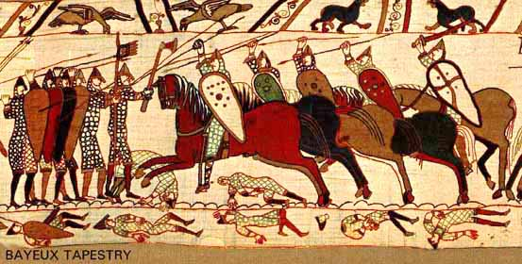
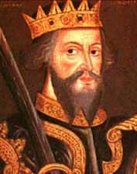
Norman Conquest
French Monarch William of Normandy seized the English throne in 1066 CE

Slide 7
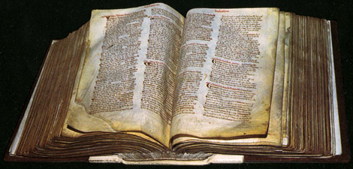
Domesday Book
William exerted total control over his lands
Domesday Book was a detailed census of every person, home, field, etc in England
Led to a system of taxation and the exchequer, or treasury, which collected taxes.

Slide 8
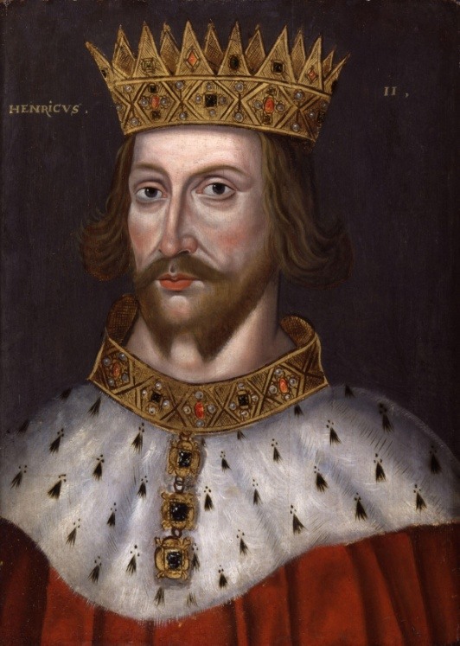
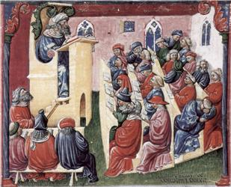
Common Law
English lands came back into English hands.
Henry II made laws that everyone had to follow
Also established juries, or group of men sworn to speak the truth.

Slide 9
Magna Carta
King John of England angered the pope and the Nobles
Pope Innocent III: placed on interdict
Nobles: angry over taxes and corruption, nobles forced John to sign the “Great Charter”
Protected rights of peasants, Church, and nobles alike.
Three important ideas of the document
Nobles had certain rights
Monarch had to obey the law
Monarch had to consult his great council before making decisions

Slide 10
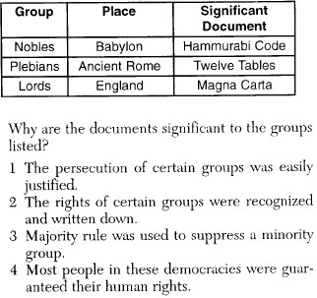

Slide 11
English Parliament
Evolved from the Great Council
Became an advisory body to the monarch and was intended to represent the interests of all people and the church.
Took knights from each lord as representatives

Slide 12
Essential Question
How did the Magna Carta and Parliament impact the English Monarchy?
Homework

