Slide 1
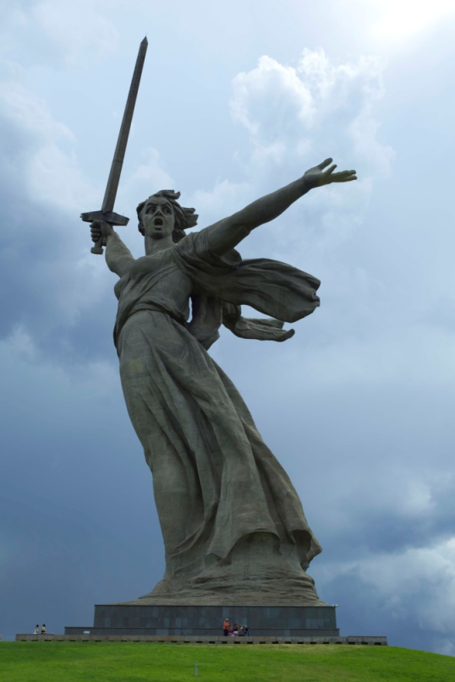
Geography and Early Civilizations of Russia
Global History and Geography I
Mr. Cox

Slide 2
Bellringer
What are the 5 largest countries in the world in terms of size and population?
Essential Question
What factors influenced the development of early Russia?

Slide 3
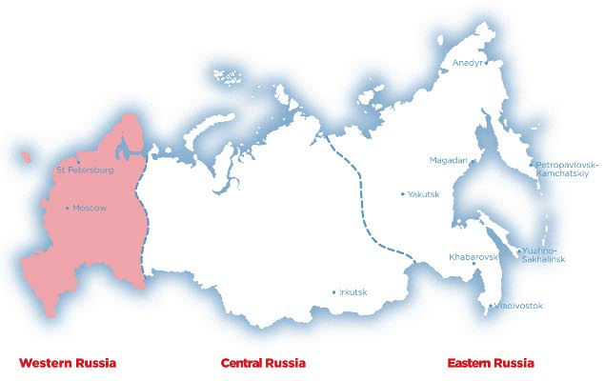

Slide 4
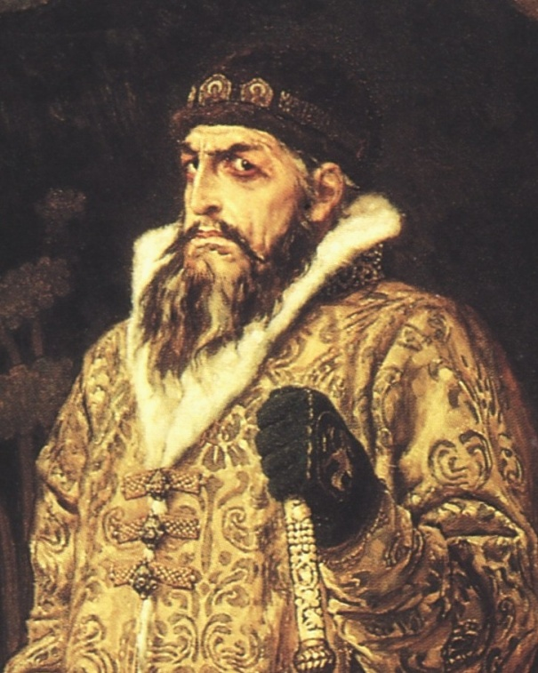
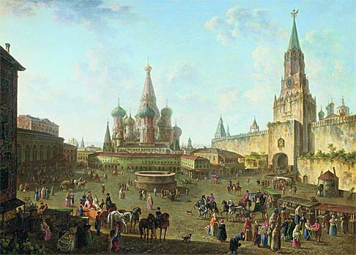
Western Russia
Experiences European influences
Center for Russian culture and history
Large percentage of Russia’s population
Moscow, St. Petersburg, Volgograd
Lot of territory lost when the Soviet Union dissolved

Slide 5
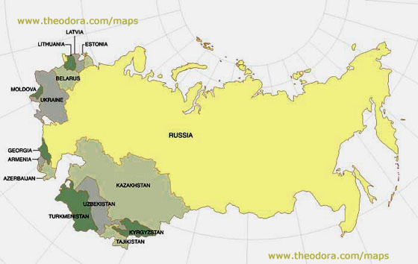

Slide 6
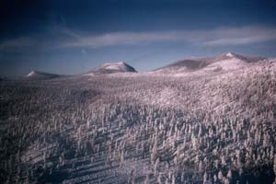
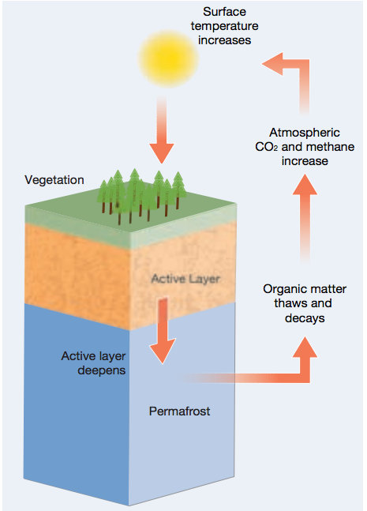
Siberia
Frozen Tundra in the center of Russia
Covered in permafrost
Layer of permanently frozen soil under the ground
Largely inhospitable, location of many jails and indigenous peoples
Home to diverse wildlife

Slide 7
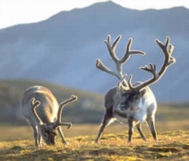
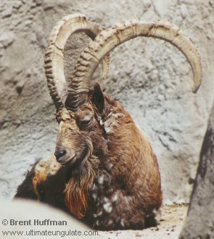
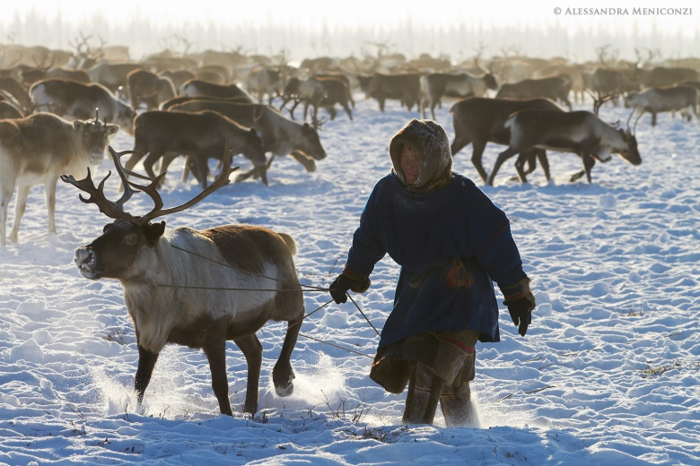
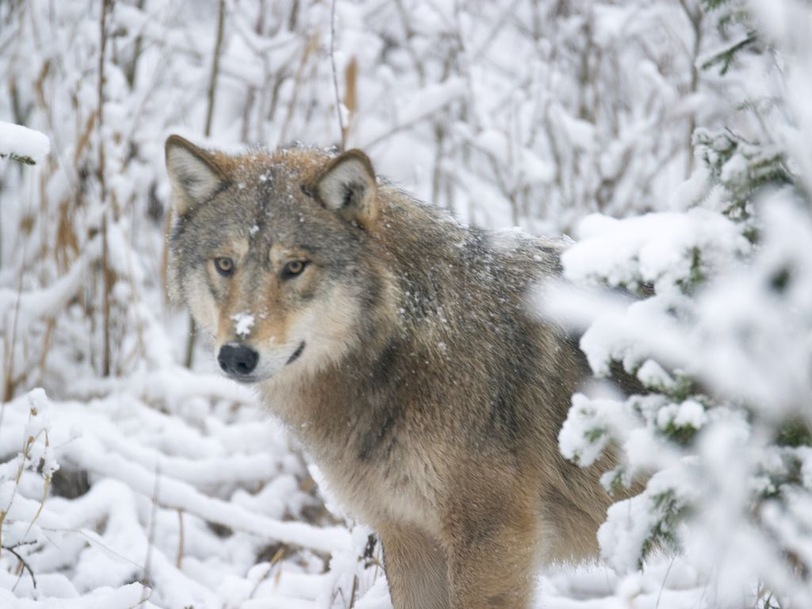
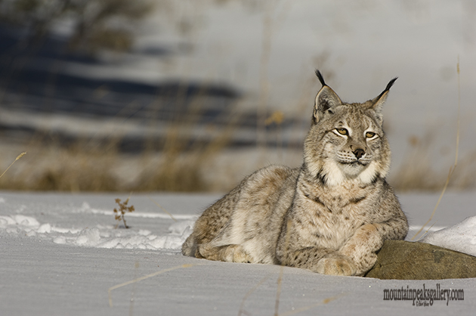

Slide 8
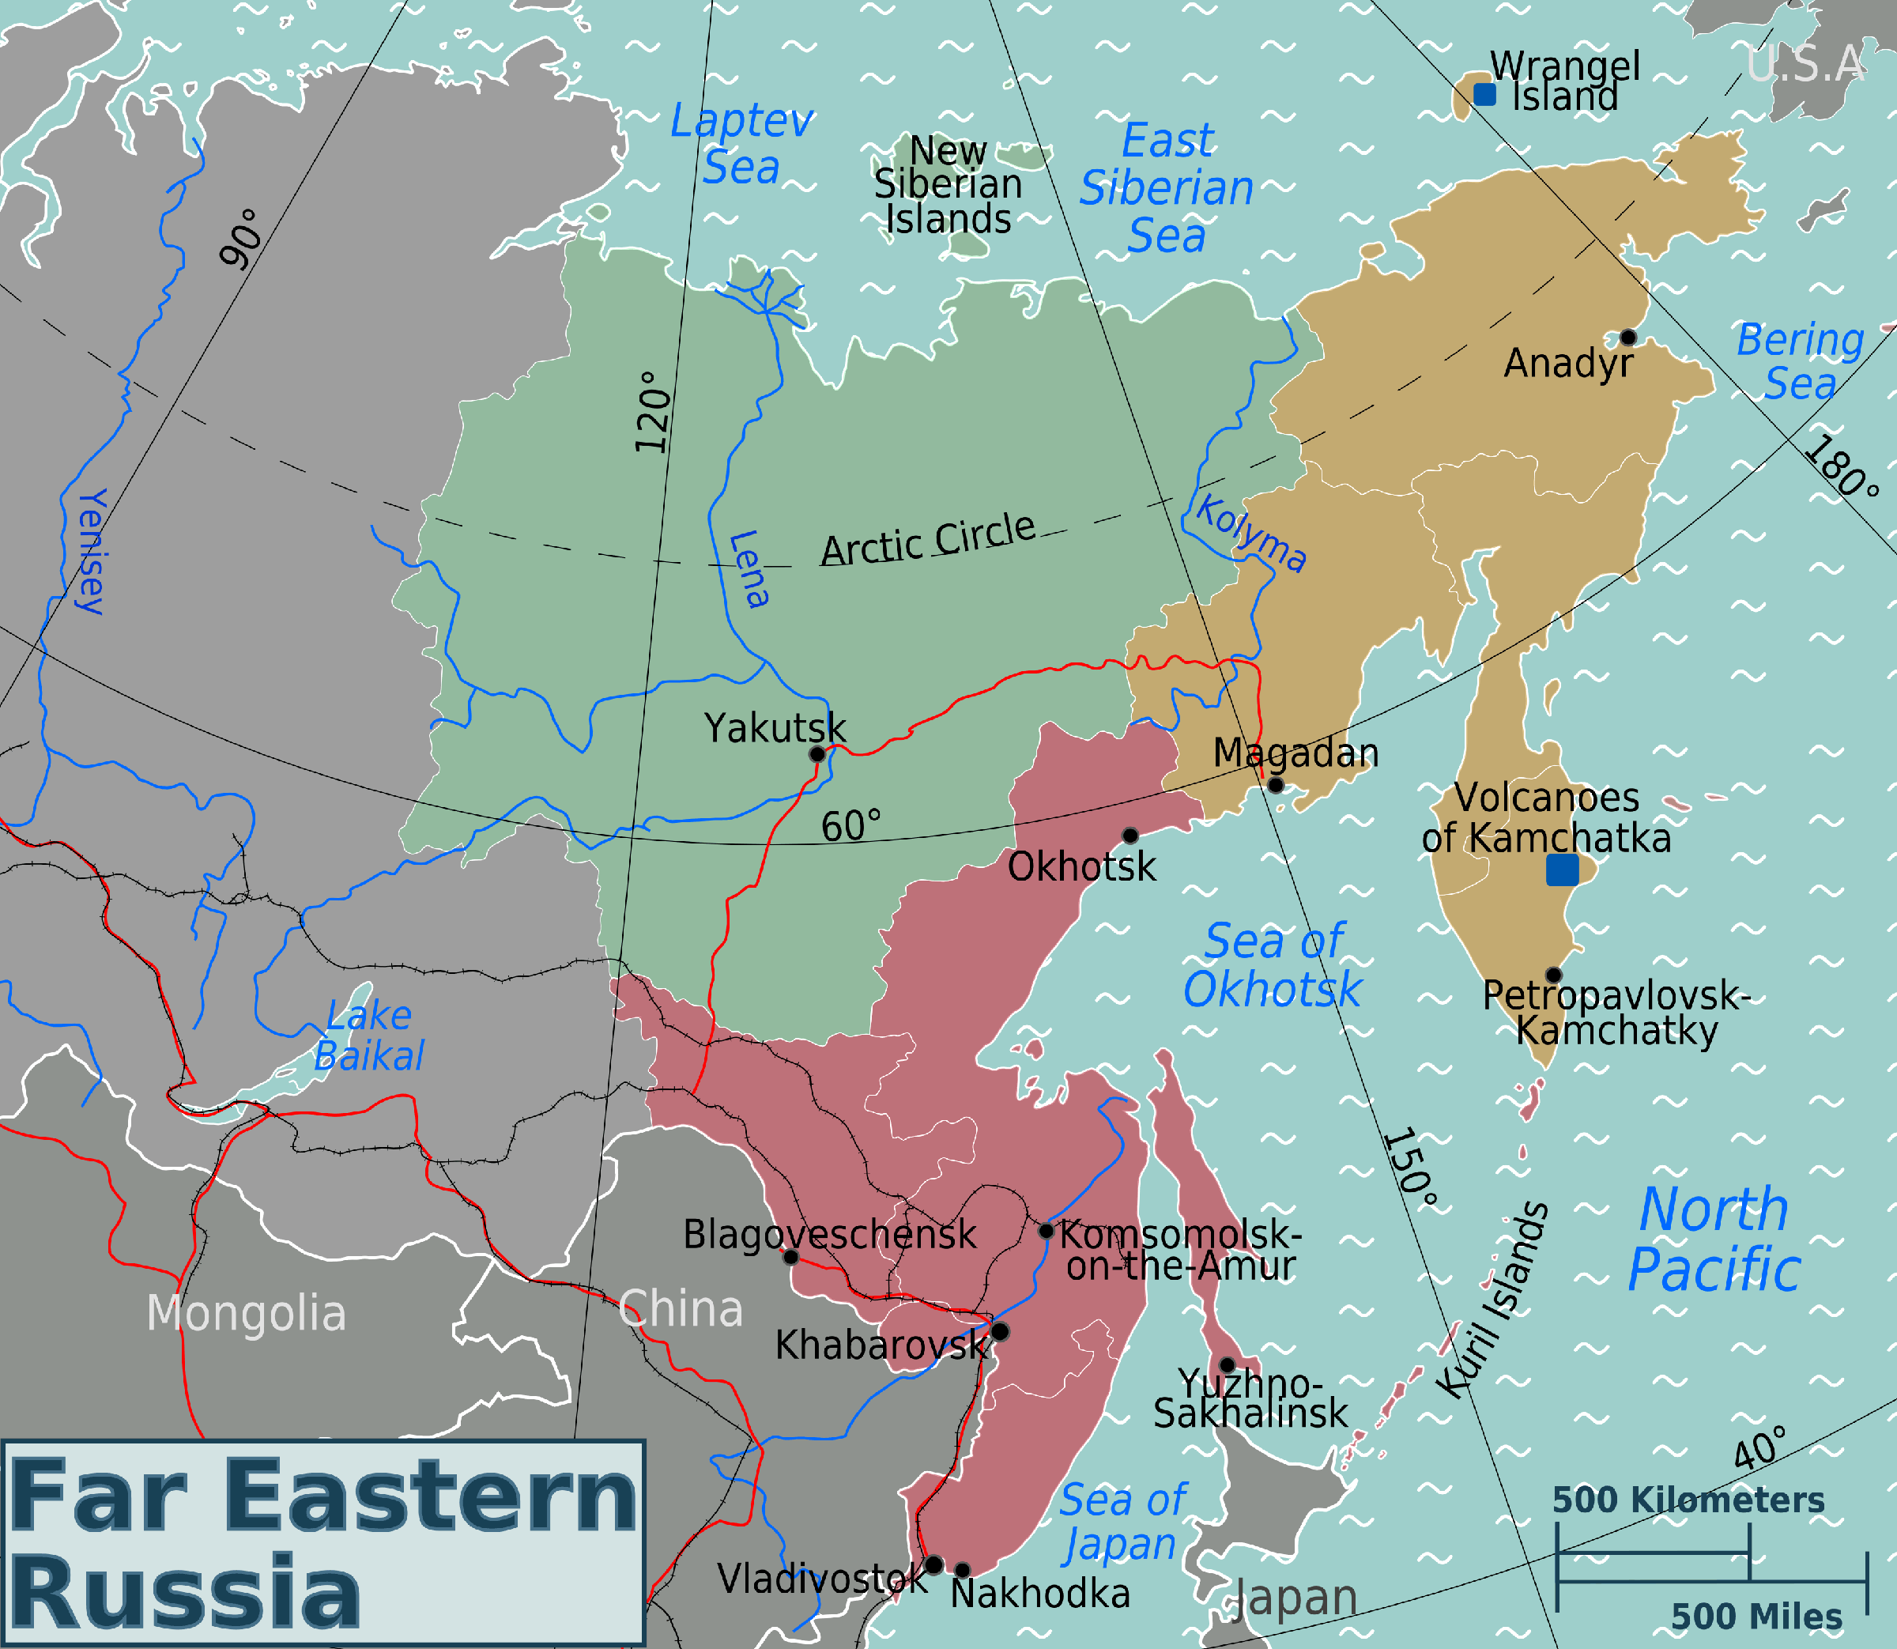
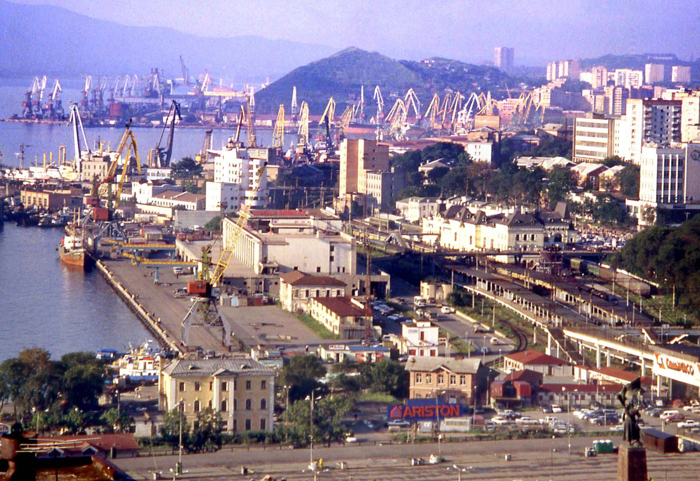
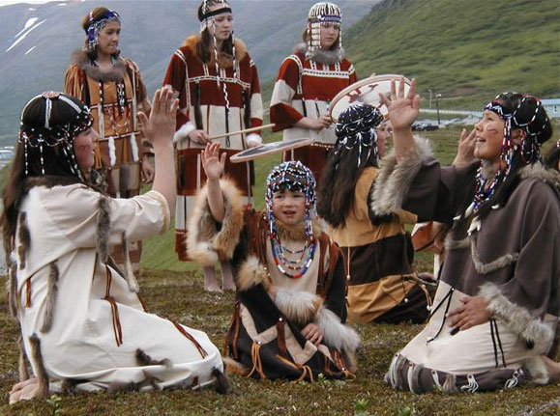
Eastern Russia
Experiences Asian influences
Less populated
Fishing, trading economy
Vladivostok: large port city

Slide 9
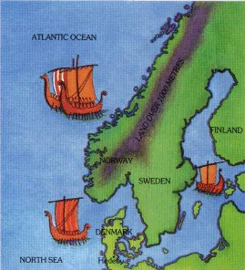
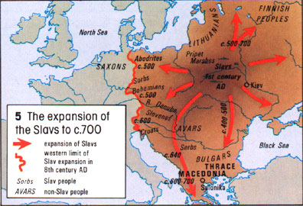
I. Russian Growth
Influences from Byzantium, Slavs (Eastern Europe), and Varangians (Vikings, Scandinavia)
This trade of goods and ideas gave rise to the city of Kiev (Kievan Rus)
Yaroslav the Wise
Trading, education

Slide 10
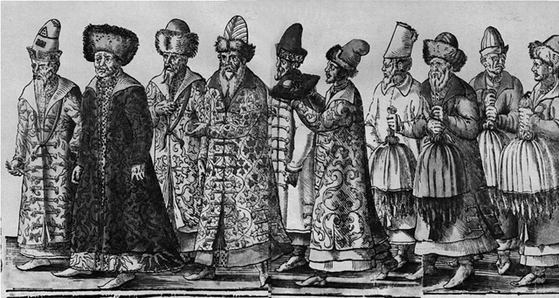
II. Centralization of Russian Power
Mongol power faded
Russian princes took back power
Focused in Moscow
Early Russian Czars emerged
Russian for Emperor
Boyars were atop social pyramid
Land-owning nobles

Slide 11
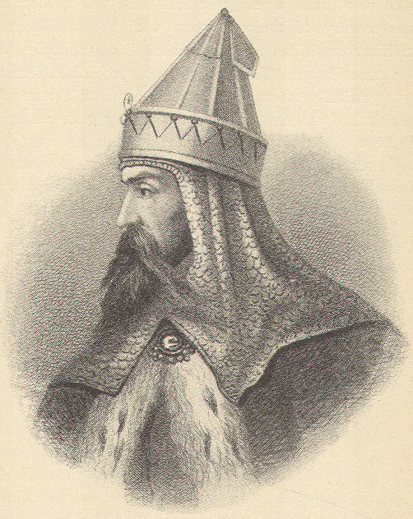
III. The Two Ivans
Ivan the Great United Russian territories Incorporated Byzantine culture through marriage Was just and right with presents, limited power of the nobles | Ivan the Terrible Grandson Oprichniki: secret police Killed rebellious boyars Harsh laws for presents Killed his own son

Slide 12
IV. Other Cultural Influences
Byzantine Empire
Cyrillic alphabet, dome architecture
Orthodox Christianity
Greco-Roman learning/traditions/customs
Mongolian Empire
Dominated Central Asia, including Russia from 1223-1480
Influenced culture, trade/economy
Also kept Russia culturally isolated from Europe during this time!!!!

Slide 13
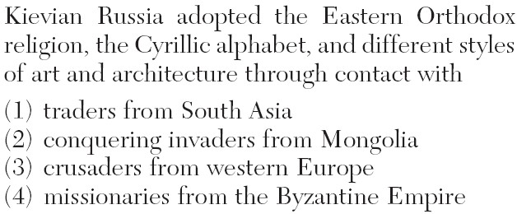

Slide 14
Essential Question
What factors influenced the development of early Russia?

