Slide 1
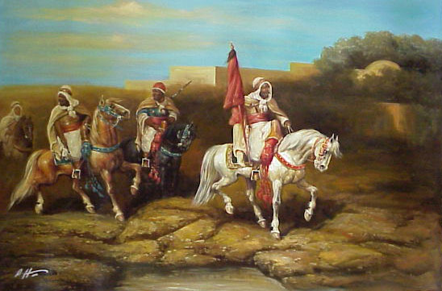
The Spread of Islam (700-1300 CE)
Global History and Geography I
Mr. Cox

Slide 2
Bellringer
What are the five pillars of the Islamic faith?
Essential Question
How did the Islamic faith spread following the death of Muhammad?

Slide 3
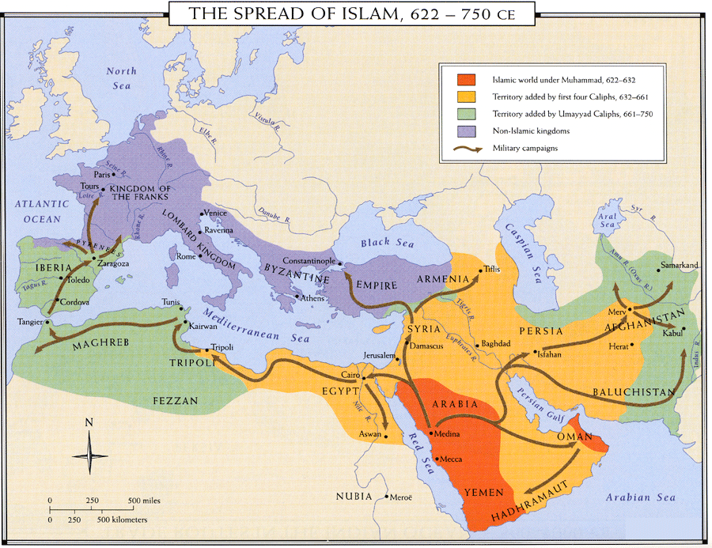
I. Islamic Faith Spreads
After Muhammad, the caliphs, or succeeding leaders of Islam, had to unite Arab tribal leaders
The first four Caliphs expanded from Arabia into Persia, Mesopotamia, and Egypt.
Superior military
Single united faith
Fighting between Persia/Byzantine
Practiced tolerance with the people they conquered, and many converted in Mesopotamia/Africa

Slide 4
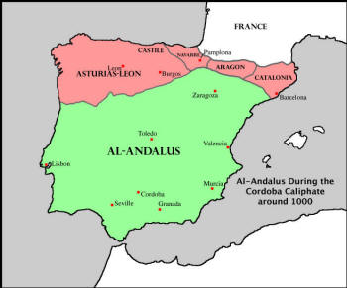
In Europe, Islamic advances were slowed by Christian kingdoms
Battle of Tours in France
Muslims would stay in Spain for hundreds of years
Islamic Spain became a cultural hub, with many great cities and grand architectural achievements

Slide 5
II. Three Sects of Islam
Islam
Sunni | Shiite (Shia) | Sufi

Slide 6
II. Three Sects of Islam
Islam
Sunni | Shiite (Shia) | Sufi
Caliphs should be chosen by the Muslim people Did not serious Muhammad as divine, only a religious leader

Slide 7
II. Three Sects of Islam
Islam
Sunni | Shiite (Shia) | Sufi
Caliphs should be chosen by the Muslim people Did not serious Muhammad as divine, only a religious leader | Only true successor to the Prophet were his descendents. These descendants were divine, or god-like

Slide 8
II. Three Sects of Islam
Islam
Sunni | Shiite (Shia) | Sufi
Caliphs should be chosen by the Muslim people Did not serious Muhammad as divine, only a religious leader | Only true successor to the Prophet were his descendents. These descendants were divine, or god-like | Attempt to communicate with God via meditation, fasting, rituals Many participated in missionary work as well

Slide 9
Quick Write
What were the causes for the schism that occurred in Islam?

Slide 10
III. Islamic Empires
Baghdad
On the Tigris River
Influenced by Persia
Very culturally rich city with education, entertainment, and fair rulers
Minarets: slender towers of Mosques
Muezzin: mosque official who called the people to prayer
Emerged after the first four caliphs
Umayyads | Abbassids

Slide 11
III. Islamic Empires
Emerged after the first four caliphs
Umayyads | Abbassids
Capital city at Damascus Used educated local officials to rule Very wealthy lords, economic tensions with the lower classes Disliked by Shiites

Slide 13
III. Islamic Empires
Emerged after the first four caliphs
Umayyads | Abbassids
Capital city at Damascus Used educated local officials to rule Very wealthy lords, economic tensions with the lower classes Disliked by Shiites | Supported by Shiites Overthrew Damascus and erased Arab domination within Islam Considered the Golden Age of Muslim culture Moved capital to Baghdad

Slide 14
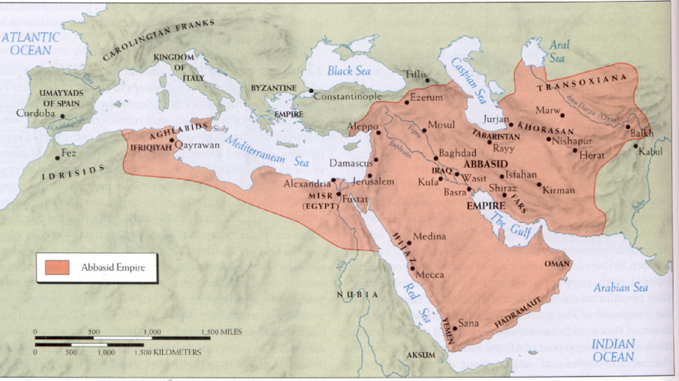

Slide 15
III. Islamic Empires
Baghdad
On the Tigris River
Influenced by Persia
Very culturally rich city with education, entertainment, and fair rulers
Minarets: slender towers of Mosques
Muezzin: mosque official who called the people to prayer
Emerged after the first four caliphs
Umayyads | Abbassids
Capital city at Damascus Used educated local officials to rule Very wealthy lords, economic tensions with the lower classes Disliked by Shiites | Supported by Shiites Overthrew Damascus and erased Arab domination within Islam Considered the Golden Age of Muslim culture Moved capital to Baghdad

Slide 16
IV. Causes for Eventual Decline
Fragmented power (local lords)
Foreign invaders
Seljuk Turks from the Central Asia
Built a strong Islamic empire under a sultan
Crusades
Mongols

Slide 17
Essential Question
How did the Islamic faith spread following the death of Muhammad?
Homework

