Slide 1
The Tang and Song Dynasties
Global History and Geography I
Mr. Cox

Slide 2
Bellringer
Review: What is a Golden Age?
Essential Question
Why is the Han Dynasty considered to be the Golden Age of Chinese Civilization?

Slide 3
I. China After the Han
400 year period of disunity
Buddhism crept into China, did not crumble as Western Europe did
The Sui Dynasty briefly united the North and South sections of China, but the Tang took over in 618 CE

Slide 4
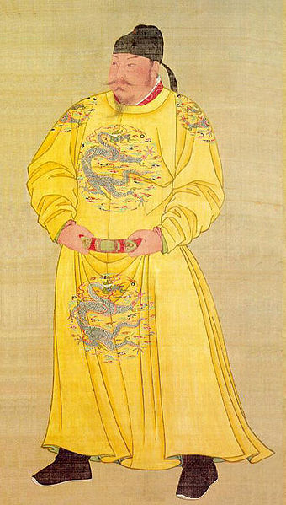
II. The Tang Dynasty
Li Yuan, a Sui general, took control with his son, Tang Taizong, when the Sui began to crumble
Tang Taizong as emperor
Venerated reformer, calligrapher, general and historian
Later Tang emperors would establish tributary states, or independent states who paid taxes to the Tang, in Central Asia, Vietnam, Tibet, and Korea.

Slide 5
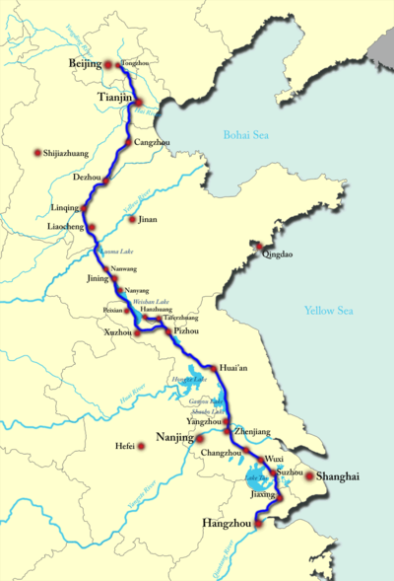
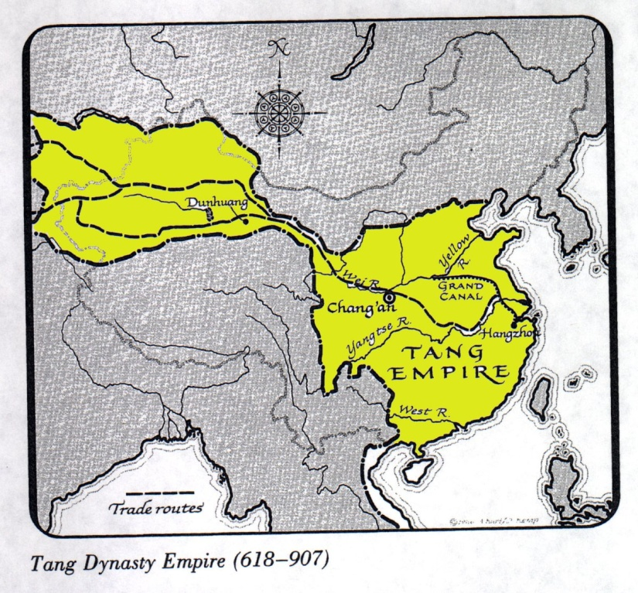
Empress Wu Zhao restored Han ruling systems and established schools
Land reforms were implemented to give land back to the peasents
The Grand Canal was built, linking the Yangtze and Yellow Rivers
By 907 CE, Islamic Empires and internal struggles led to the collapse of the Tang

Slide 6
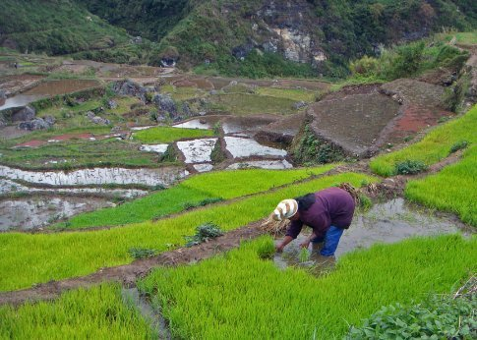
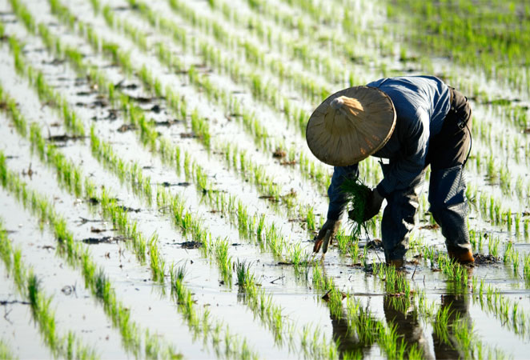
III. The Song Dynasty
A short period of disunity separated these two dynasties, as the Song emerged in 960 CE
Northern invaders kept the Song generally to the South of the Yellow River
Agriculture shifted (wheat in the north to rice in the south)
Trade continued to flourish with western civilizations

Slide 7
Tang and Song Society and Accomplishments
Society | Accomplishments
Gentry – wealthy landowning class who were well educated, held government jobs, and held to Confucian teachings | Pagodas – multistoried temple with curved eaves at the corners Porcelain – artistic pottery (modern ‘China’) Literature – massive amount of history, religion, and philosophical writings Poetry – most respected form of literature by the gentry Paintings – of landscapes and portraits were prominent among the gentry as well Technology – mechanical clocks, gunpowder, printing blocks
Peasants – majority of the people who worked the land and made other goods. Could move up in the class rank too
Merchants – Could accumulate massive amounts of wealth, but still viewed below peasants
Women – had an elevated position compared to earlier dynasties, but still had restricted rights and high expectations (Footbindings, etc)

Slide 8
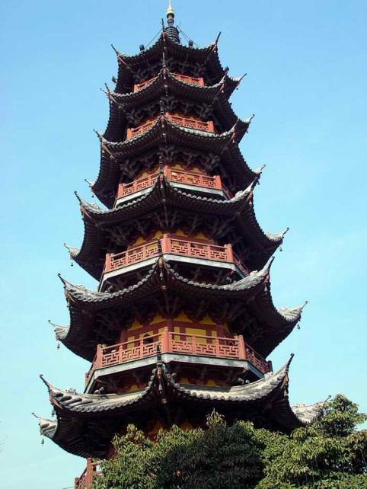
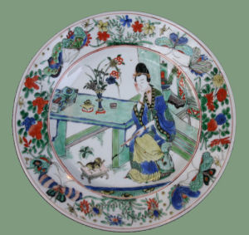
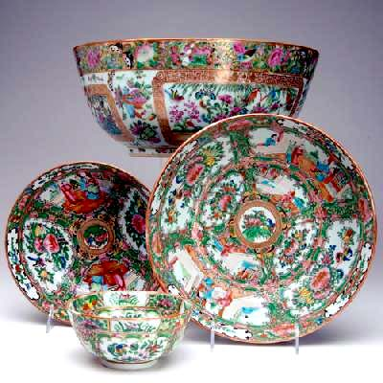
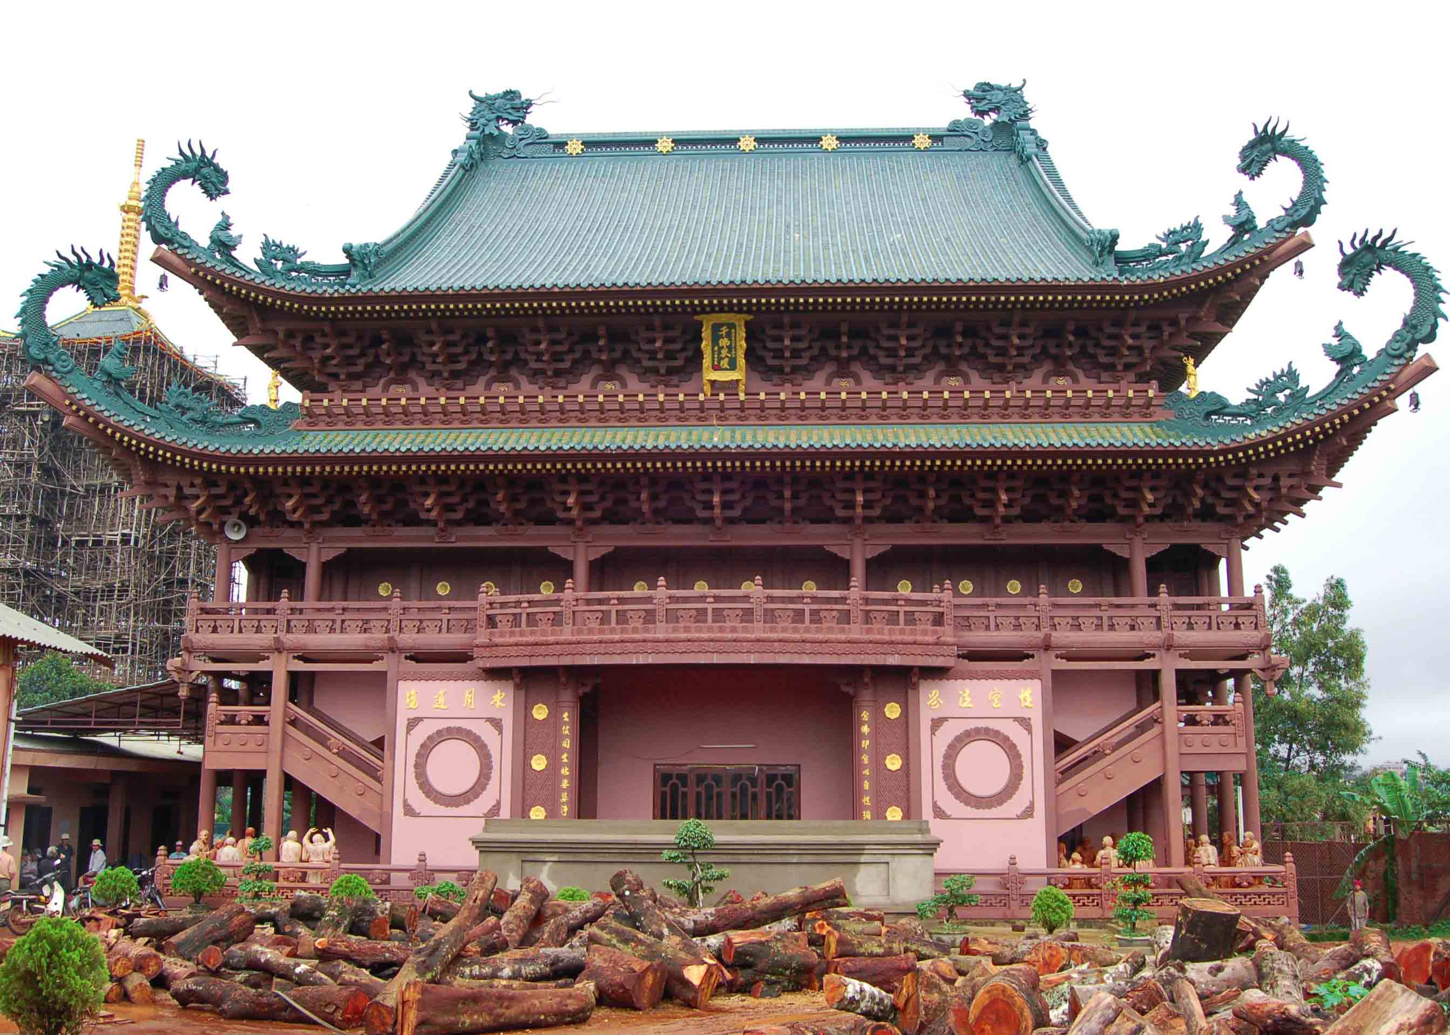
Pagodas and Porcelain

Slide 9
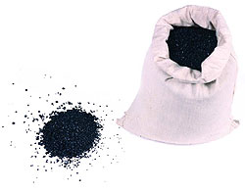
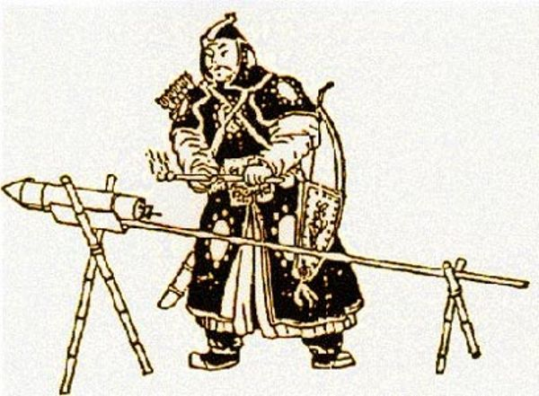
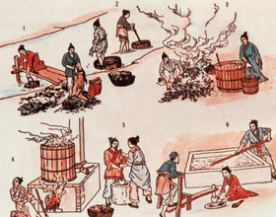
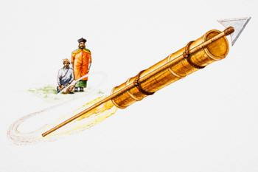
Gunpowder and Fireworks
https://www.youtube.com/watch?v=mqHVRgCkCDE

Slide 10
A little gross, turn away if you’re squeamish

Slide 11
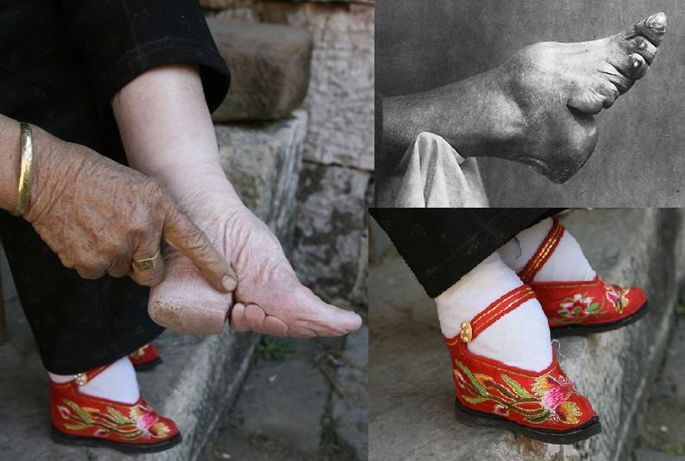
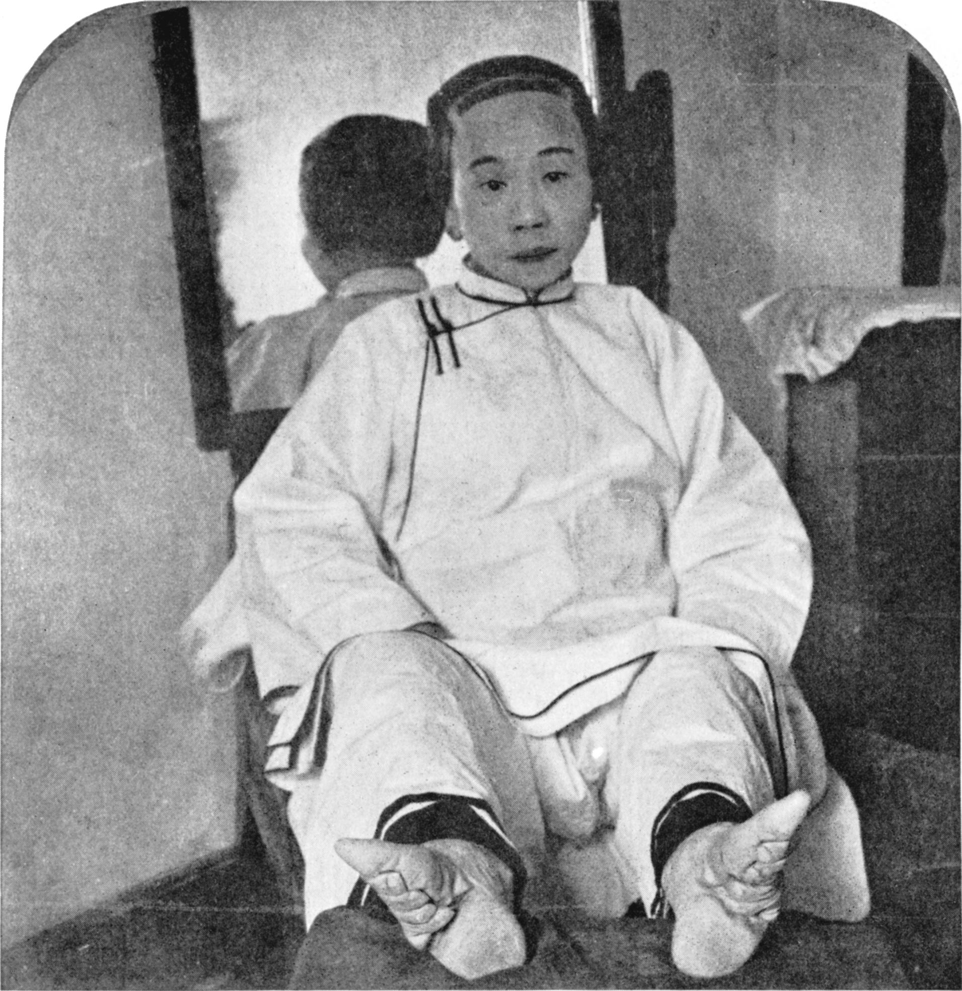
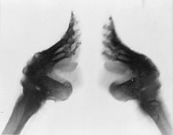
Foot bindings

Slide 12
Essential Question
Why is the Han Dynasty considered to be the Golden Age of Chinese Civilization?

