Slide 1
The Aztec Empire
Global History and Geography I
Mr. Cox

Slide 2
Bellringer
Review: Which characteristics were essential to ancient social structures?
Essential Question
How did the Aztec Civilization expand on Mayan achievements?

Slide 3
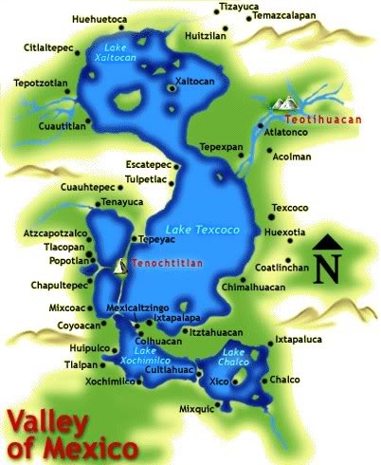
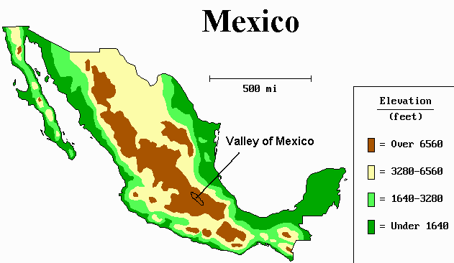
I. Aztec Civilization
Emerged in the valley of Mexico: Teotihuacan
The city gave birth to Aztec culture
Settled around Lake Texcoco
Tenochtitlan: floating city.
Expanded and took over much of south-central Mexico
Tribute: payment from conquered peoples

Slide 4
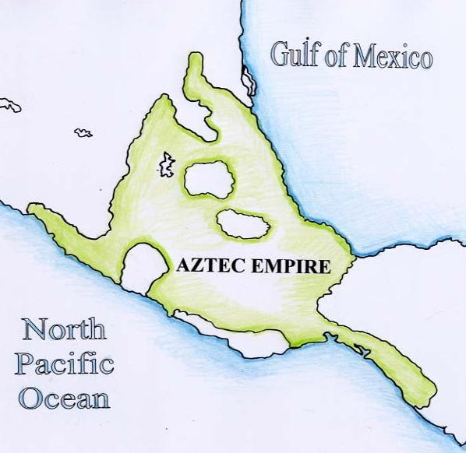
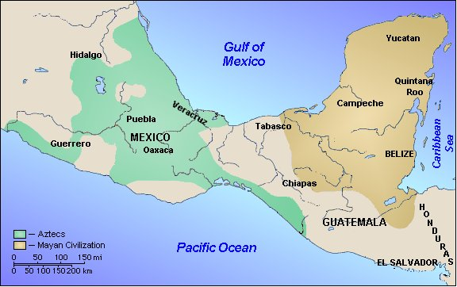

Slide 5
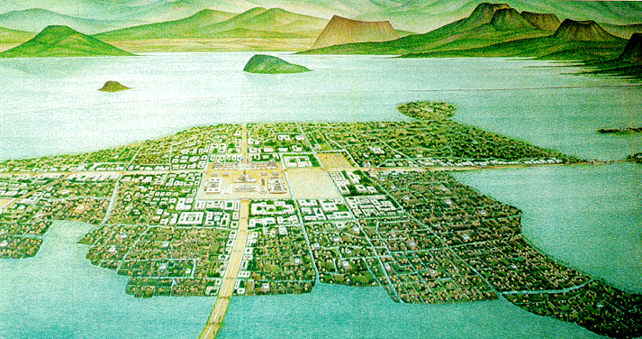
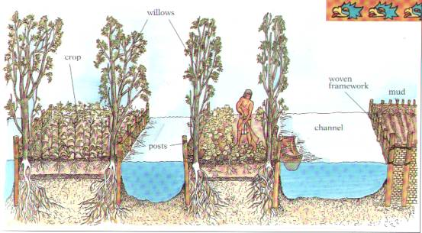
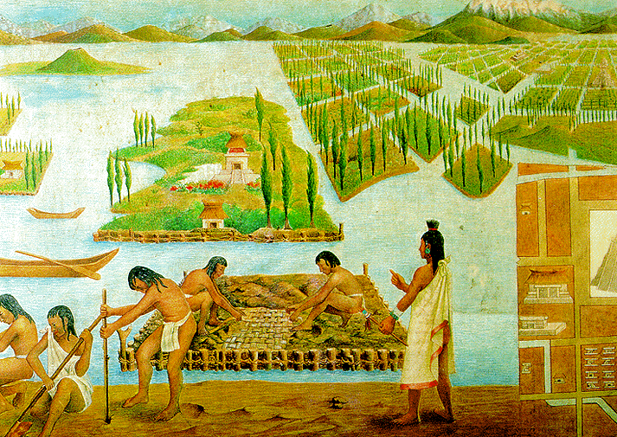
Chinamps: artificial islands made of earth that were anchored to the shallow lake bed
http://www.youtube.com/watch?v=_nS6MpVbB_g

Slide 6
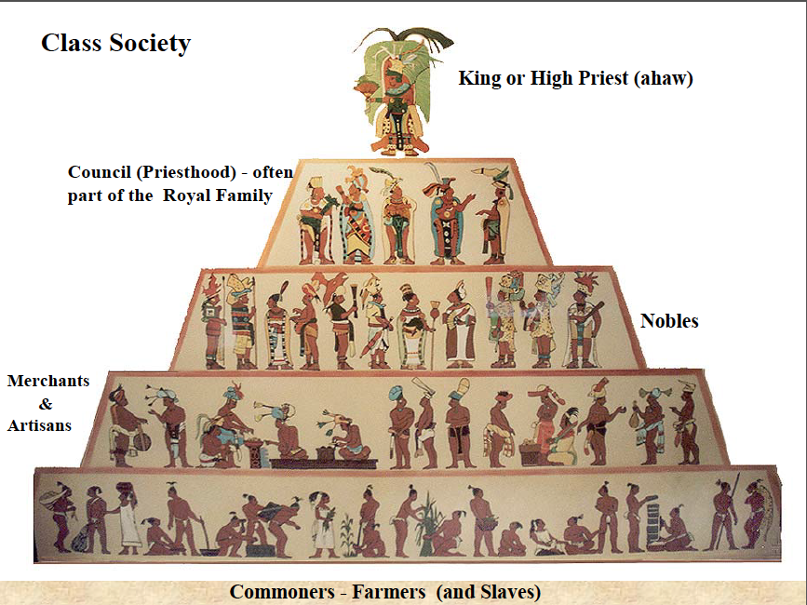
II. Aztec Culture
Capital City at Tenochtitlan
Emperor, chosen by a council of nobles and priests
Judges, priests, governors, government officials
Soldiers
Commoners, farmers
Slaves (prisoners of war and criminals)

Slide 7
Quickwrite
How was the social structure of the Aztecs similar to that of other ancient civilizations?

Slide 8
Economy: trade within and outside the empire
Religion: priests were important, Sun God, temples
Huitzilopochtli battled for the Sun to rise each morning
To aid in this struggle, sacrifices were offered daily
Priests were keepers of knowledge
Written records, calendar

Slide 9
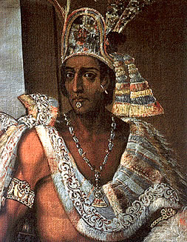
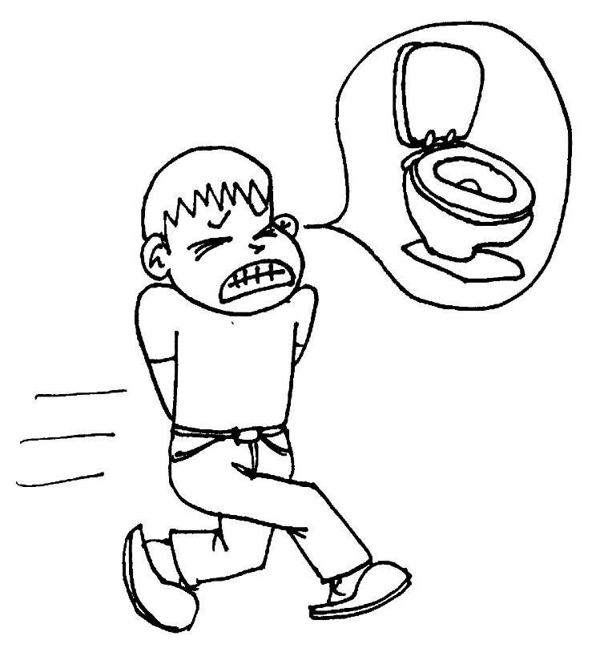
III. Fall of the Aztecs
Waited for their Sun God to appear on Earth
Spanish conquerors tricked the Aztec Emperor Montezuma
Placed a curse on the Spanish, said he would have his revenge
Montezuma’s Revenge: disease, comes out of both ends. If left untreated, can cause dehydration and death

Slide 10
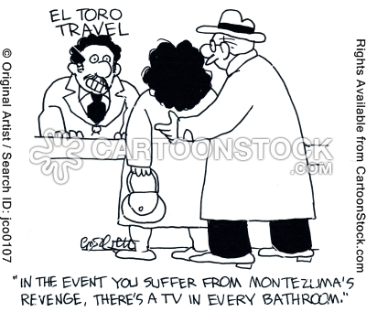

Slide 11
Essential Question
How did the Aztec Civilization expand on Mayan achievements?

