Slide 1
The Commercial Revolution
Global History and Geography I
Mr. Cox

Slide 2
Bellringer
Define: economy
What were the causes and impacts of the Commercial Revolution?
Essential Question

Slide 3
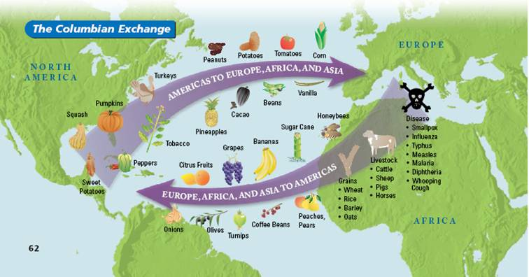
I. Global Exchange
Due to the explorations of Columbus and other Europeans a massive global marketplace developed for the exchange of culture and goods across the Atlantic
Became known as the ‘Columbian Exchange’
Impacts
Population increases and changes (migrations) Spread of new goods to new markets New business practices emerged to regulate this activity

Slide 4
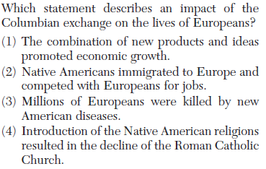

Slide 5
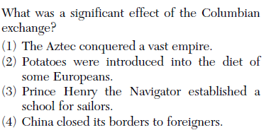

Slide 6
II. The Commercial Revolution Begins
Overall change in the traditional business model of Western Civilization
Began as economic activity increased
Focused around major European cities, especially those in Italy, but soon spread to colonies
Major Impacts/Changes
Price Revolution
Capitalism
New Business Methods
Mercantilism

Slide 7
Price Revolution
Inflation, or sharp increase in money supply, occurred for several reasons
Discovery of Spanish silver
Increase in demand for goods and money supply
Monopoly on foreign markets

Slide 8
Capitalism
Adam Smith, The Wealth of Nations
Economic system that emphasizes the making of money for a private entity
Entrepreneurs were capitalist merchants who began investing money in hopes of making a profit
Gave rise to new business practices and changed role of guilds

Slide 9
New Business Methods
Partnerships & Joint Stock Company | Used to raise capital for larger projects. Less financial risk to the individual
Banks | Provided money lending services as well as issuing Bills of Exchange.
Bills of Exchange | Worked like modern checking account. Merchants could purchase the Bills for gold and redeem their gold at another bank.
Insurance | Paid a small fee to insure goods during travel.

Slide 10
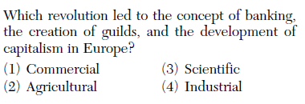

Slide 11
Mercantilism
Economic system that focused on the relationship between colonies and mother country.
It was the role and purpose of the colony to help richen the mother country
Used by European nations with their colonies
Led to high tariffs, or taxes on imported goods
Had negative impacts for the majority of people as their individual well-being was second rate to that of the empire

Slide 12
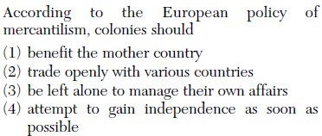

Slide 13
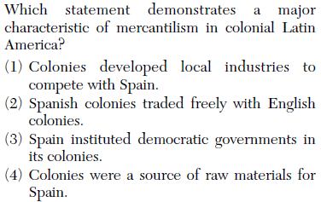

Slide 14
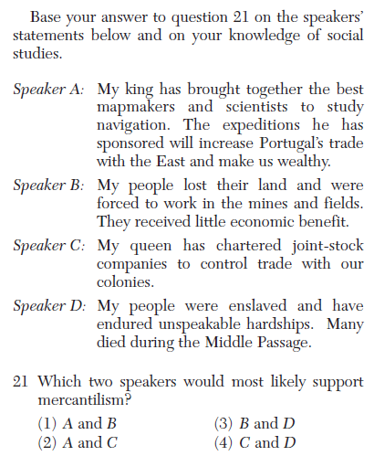

Slide 15
http://www.youtube.com/watch?v=HQPA5oNpfM4

Slide 16
Essential Question
What were the causes and impacts of the Commercial Revolution?
Homework

