Slide 1
The Enlightenment in Europe
Global History and Geography I
Mr. Cox

Slide 2
Bellringer
Review: what was the Renaissance?
What were the causes for the Age of Enlightenment?
Essential Question

Slide 3
Causes
Sparked by the Scientific Revolution and Reformation
New ways of thinking/challenging traditional beliefs
Basis in experimentation and reason
Way of thinking began to be applied to morals and government
Began the Age of Reason/Enlightenment

Slide 4
Thinkers of the Enlightenment
Thomas Hobbes | John Locke
Pg. 545 Social Contract | Pg. 545 Natural Rights
Baron de Montesquieu | Voltaire
Pg. 546 Separation of Powers | Pg. 546 Who did he attack in his writings?
Denis Diderot | Jean-Jacques Rousseau
Pg. 546-547 Encyclopedia | Pg. 547 Rousseau’s Social Contract

Slide 5
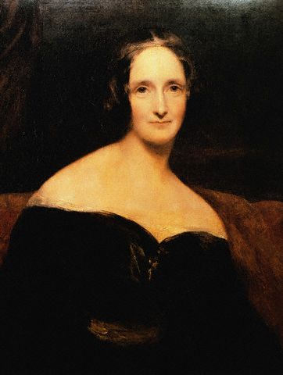
Women and the Enlightenment
Mary Wollstonecraft – 1792
“A Vindication of the Rights of Woman”
Women should be able to decide what was in her own best interest – not her husband or father.

Slide 6
Essential Question
What were the causes for the Age of Enlightenment?
w was the limited monarchy of England different than the absolute monarchies of Spain, Russia, and France?
Homework

