Slide 1
The Incan Empire
Global History and Geography I
Mr. Cox

Slide 2
Bellringer
What methods have other civilizations used to farm in the past?
Essential Question
How was Incan civilization different from the Mayas and the Aztecs?

Slide 3
I. Predecessors to the Inca
Chavin: art and religion Mochica: Developed terrace farming and road systems
Nazca: Left behind glyphs
Pictograph or symbol carved into a surface
Each fell to the Incas, but influenced their culture as well

Slide 4
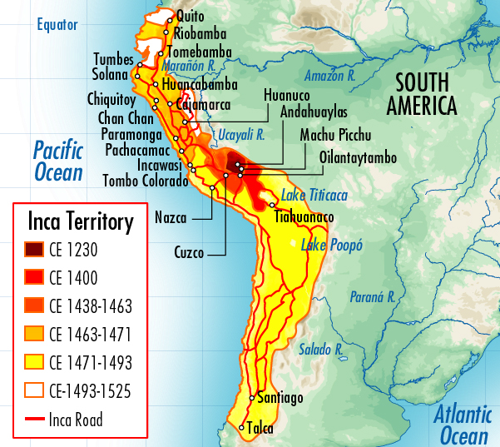
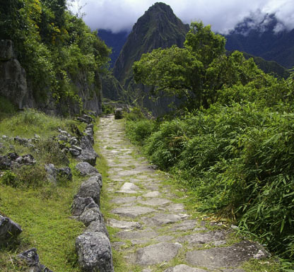
II. Incan Civilization
Emerged in Peru (Cuzco) and spread through the Andes Mountains
Sapa Inca: God-Emperor with complete, divine rule
Coya: wife who carried out important religious/civic duties
Never wore same garments twice
Records kept on quipu
Collection of knotted and colored strings, kept dates/crop yields

Slide 5
Quickwrite
How was the government of Inca similar to other ancient civilizations?

Slide 6
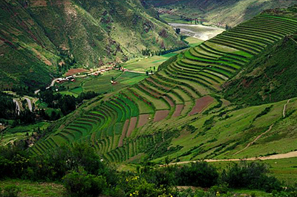
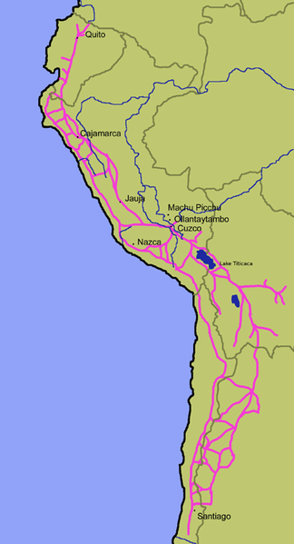
III. Incan Life
Majority of people were famers or runners
Farmers: terrace farming and careful irrigation
Runners: messengers along roads from city to city
Other specialized jobs
Metal workers: alloy, or blend, metals
Priests: important in government and medicine

Slide 7
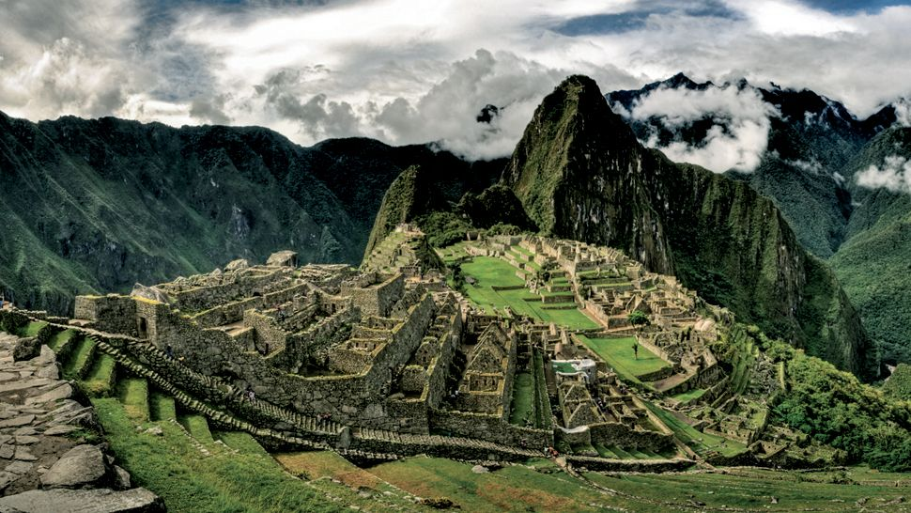
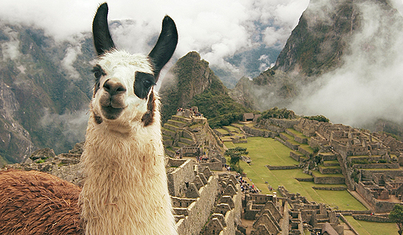
IV. Machu Picchu
Ancient Incan city in Peru
7000 ft. above sea level
Stones of city buildings are each custom cut to fit, no mortar or tar
Remains a popular tourist site today
http://www.youtube.com/watch?v=P2YBVlgqqco

Slide 9
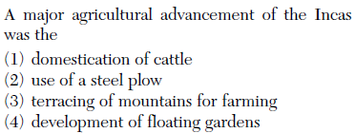

Slide 10
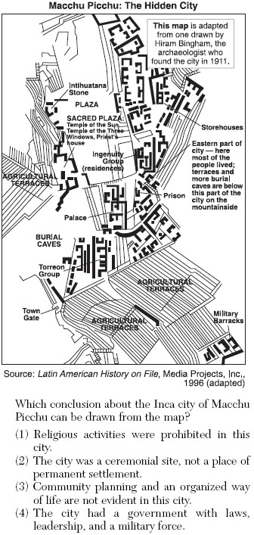

Slide 12
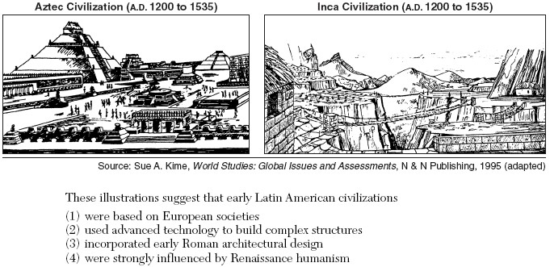

Slide 13
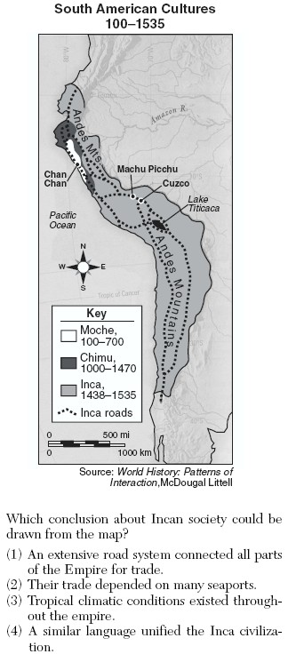

Slide 14
Uncontacted Tribes in the Amazon
Indian tribes still exist in the world that have not yet made contact with the “modern” world
Live lives of simplicity and free of big governments
Way of life is threatened due to illegal logging of the Amazon Rain Forest and pollution of the River
http://www.youtube.com/watch?v=sLErPqqCC54

Slide 15
Essential Question
How was Incan civilization different from the Mayas and the Aztecs?

