Slide 1
The Mayan Empire
Global History and Geography I
Mr. Cox

Slide 2
Bellringer
What places are located in ‘Latin’ ‘Middle’ America?
Essential Question
How was ancient Mayan Civilization similar to other ancient civilizations?

Slide 3
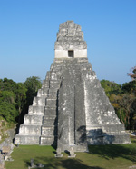
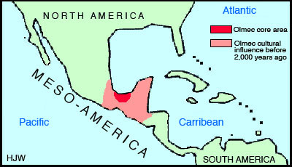
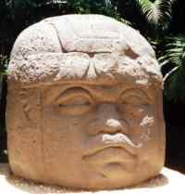
I. The Olmecs
Earliest American civilization
Mexican Gulf Coast
1400 BC- 500 BC
Rich tombs and temples
Priests on top of social pyramid
No cities, had worship centers
Trading economy

Slide 4
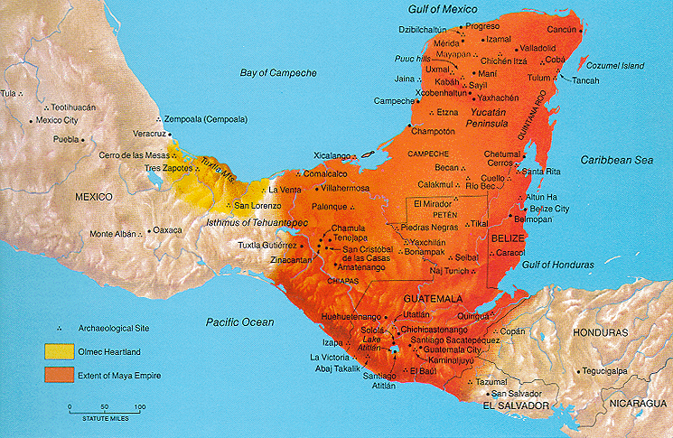
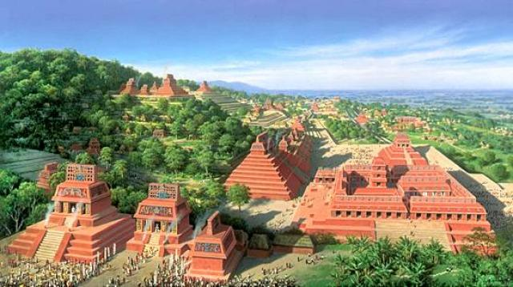
II. Mayan Civilization
Influenced by the Olmecs
Cut down trees and raised land for agriculture, brought water to crops
Large stone temples and poles with historical carvings
Ball games (soccer?)
Large cities (Tikal)

Slide 5
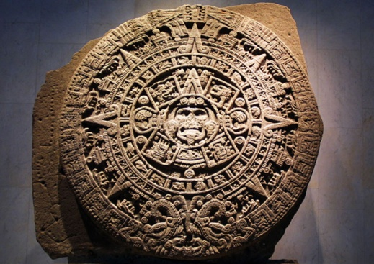
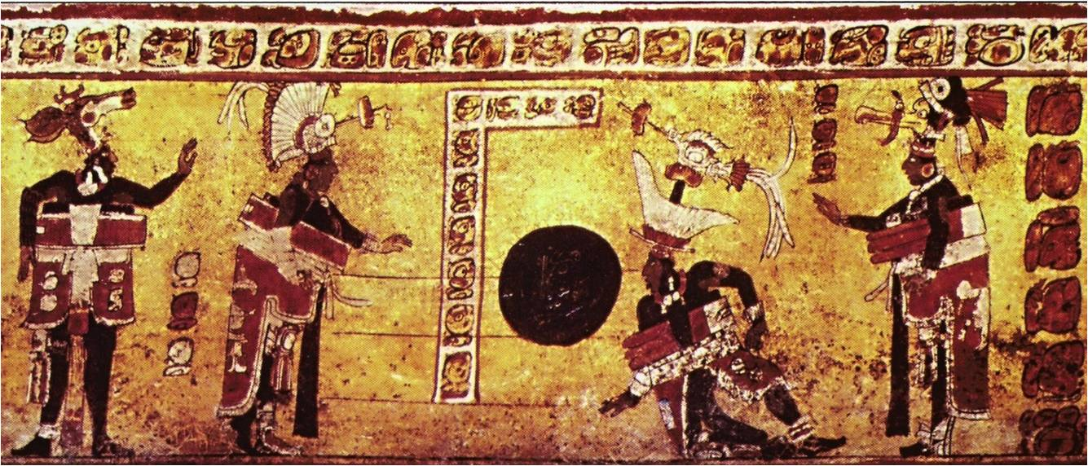
Social Classes
Ruler
Nobles (generals and government officials)
Priests (women had some power as well)
Learning
Writing system – symbol language, mostly about farming
Calendar (Math and Astronomy) to keep track of seasons
Books (made of tree bark) to record time of sunrise

Slide 6
Quickwrite
How were the Olmecs and Mayans different?

Slide 7
III. Decline
“Lost Cities” were discovered
Possible explanations
Overpopulation, therefore overuse of soil
Over-taxation to support wars
Mayan culture and languages exist today

Slide 8
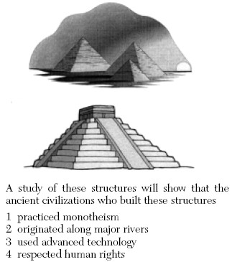

Slide 9
Essential Question
How was ancient Mayan Civilization similar to other ancient civilizations?

