Slide 1
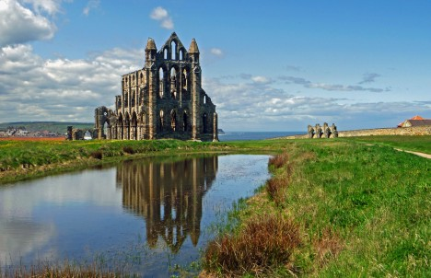
The Medieval Church
Global History and Geography I
Mr. Cox

Slide 2
Bellringer
What are the three major monotheistic world religions?
Why did the power of the Christian church grow during the Middle Ages in western Europe?
Essential Question

Slide 3
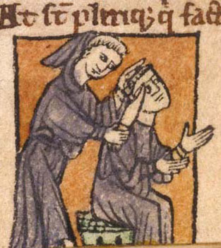
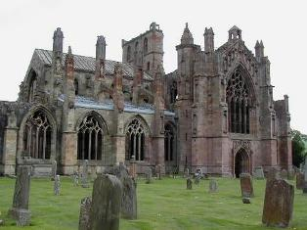
I. Changes in the Church
During the Middle Ages, the Catholic church evolved.
Monasteries, or centers of religious study and living, began to emerge.
People desired alternatives to manorial life.
Benedictine Rule
Pope Benedict organized a set of three vows by which monks and nuns should live by

Slide 4
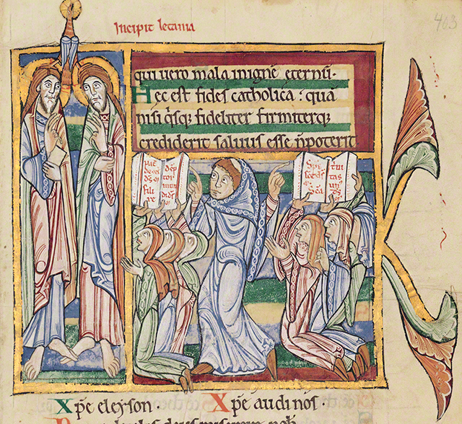
Cont’d
http://www.youtube.com/watch?v=a_oeKXEMpsY
Monks and nuns would be required to live strict lives of work, prayer, and service to others.
Schools
Missionaries
Copying of sacred texts

Slide 5
Quickwrite
What were monasteries? What was their role in Medieval Europe?
After you have answered the question, share with the person sitting next to you.

Slide 6
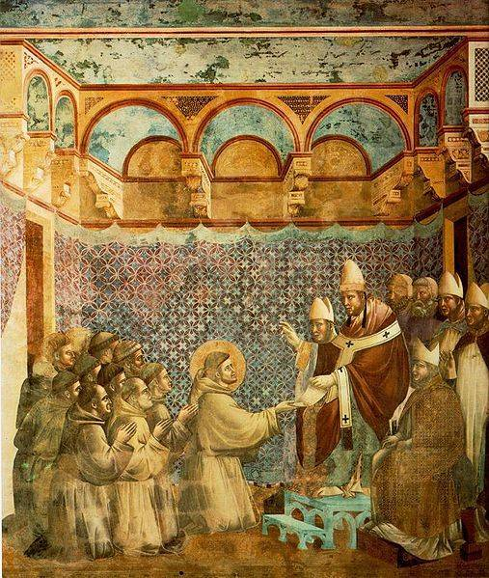
II. The Power of the Church Grows
The Pope began to exercise power over secular (political, social) life and nonsecular (religious) life
Papal Supremacy: authority of the Pope over all worldly leaders
Established a hierarchy of officials to monitor the Church throughout Europe
Canon Law: body of Church laws
Excommunication: banishment from the Church
Interdict: excommunication of an entire town

Slide 7
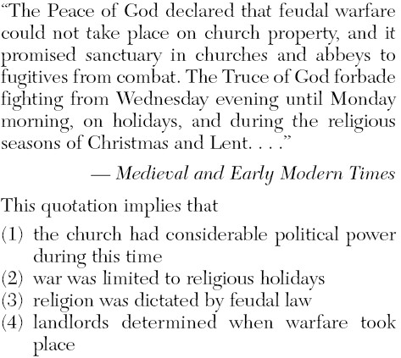

Slide 8
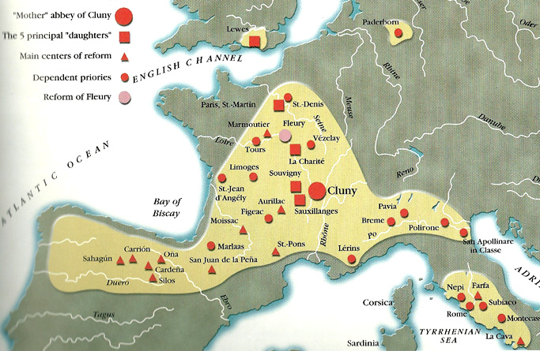
III. Reform Movements
As the years progressed, the Church had become quite lax and undisciplined, prompting reform.
Cluniac Reforms
Abbot of Cluny revived Benedictine Rule, removed nobles from monasteries, and only took devoted monks.
Simony, or the selling of church offices, became prohibited.
Francis of Assisi led friars, or traveling monks who would visit the various towns in Europe and teach the gospel.

Slide 9
IV. Judaism During the Middle Ages
The rise of the Christian church in Europe brought changes to the lives of Jews in the region
At first, Jews lived peacefully alongside Christians across Europe
Eventually, people of Jewish faith began to face persecution and prejudice, or antisemitism, for various reasons
Death of Jesus
Scapegoat for famine, drought, economic problems
Caused Jewish migration to Eastern Europe.

Slide 10
Essential Question
Why did the power of the Christian church grow during the Middle Ages in western Europe?
Homework

