Slide 1
The Mongolian Empire
Global History and Geography I
Mr. Cox

Slide 2
Bellringer
Review: Define the Persian policy of tolerance. How did it allow Persia to rule its conquered lands?
Essential Question
How did the Mongolian Empire promote global connections and cultural diffusion?

Slide 3
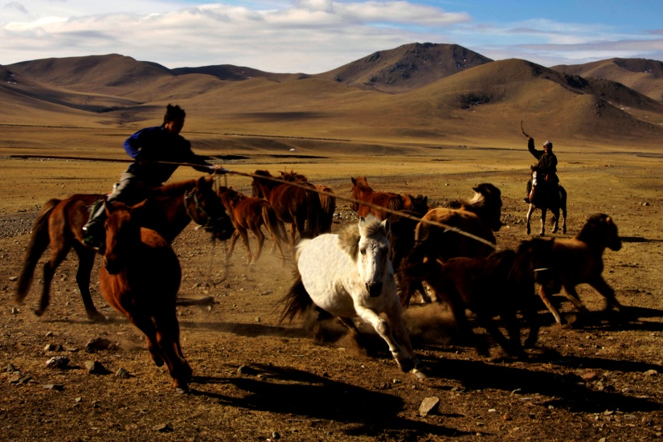
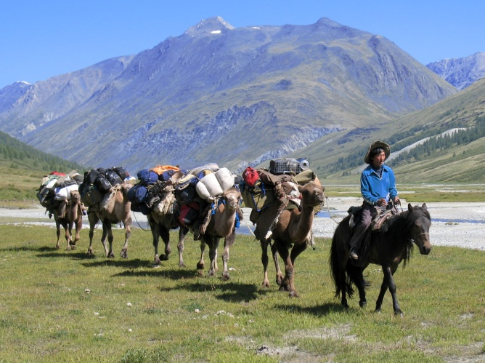
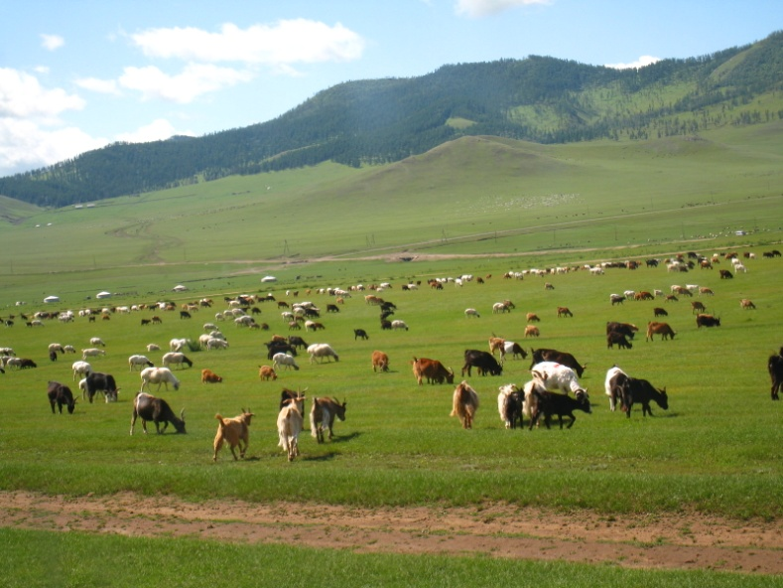
I. Mongolia
North of China (Central Asia)
Steppe: open, treeless grassland
Compiled of nomadic tribes
People relied on agriculture and the horse (herding, grazing)
Blend of Russian and Asian cultures

Slide 4
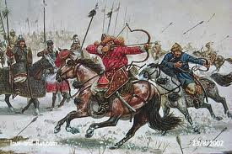
II. Genghis Khan
Young Warlord who united the nomadic tribes
“The Golden Horde”
Empire spread from Eastern Asia to Europe
Descendents continued to expand
Kublai Khan occupied China, Korea, Tibet, and Vietnam

Slide 5
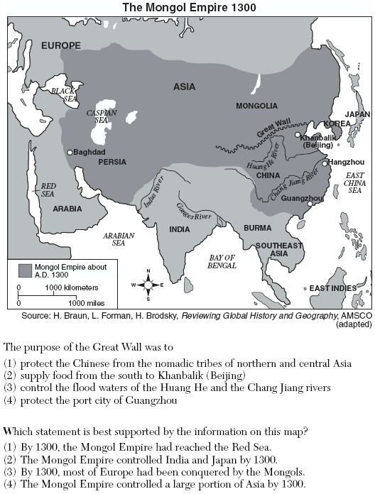

Slide 6
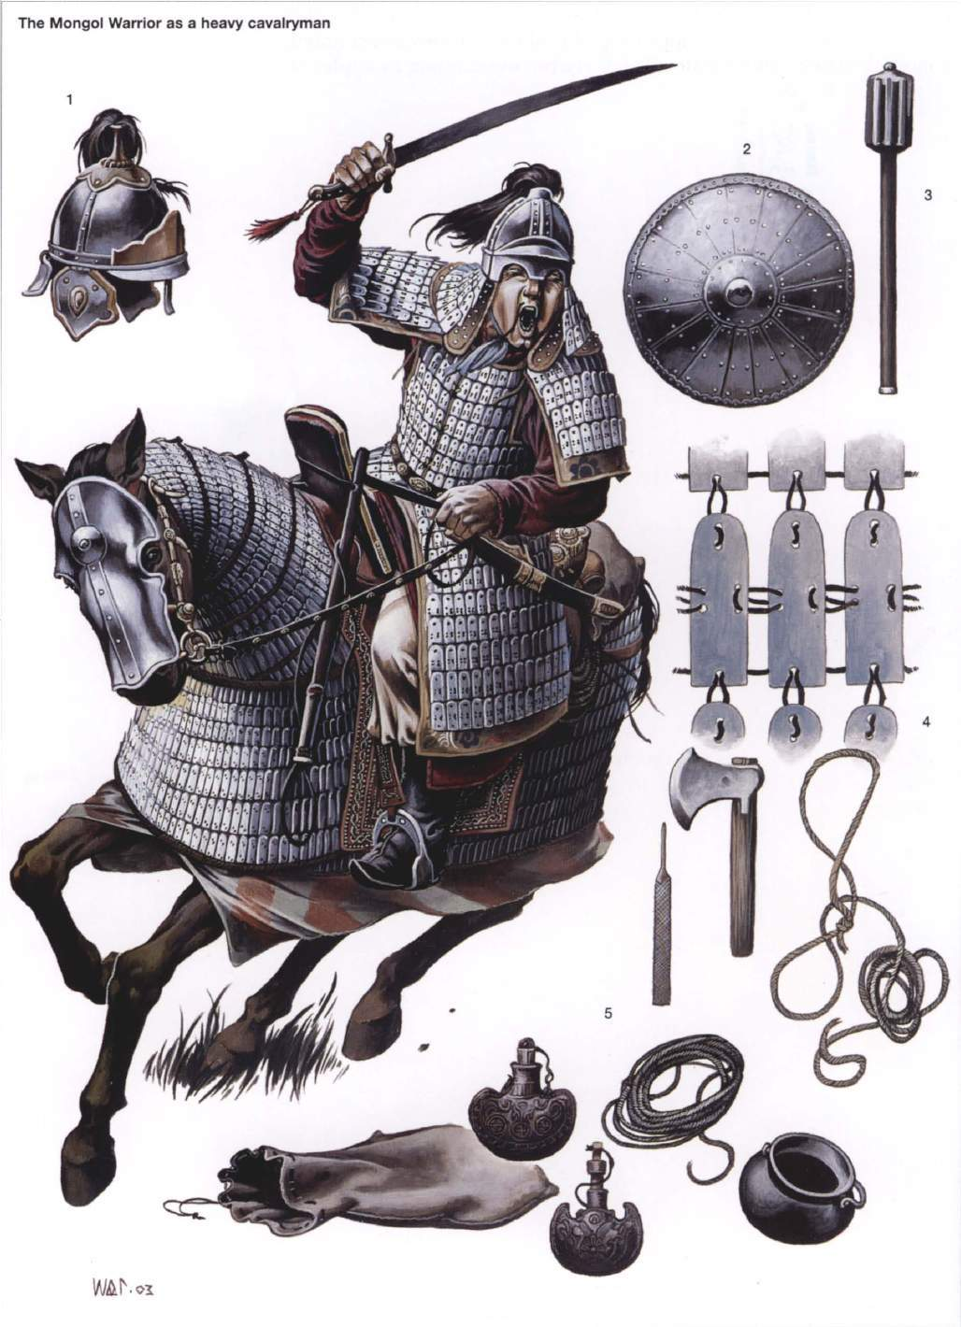
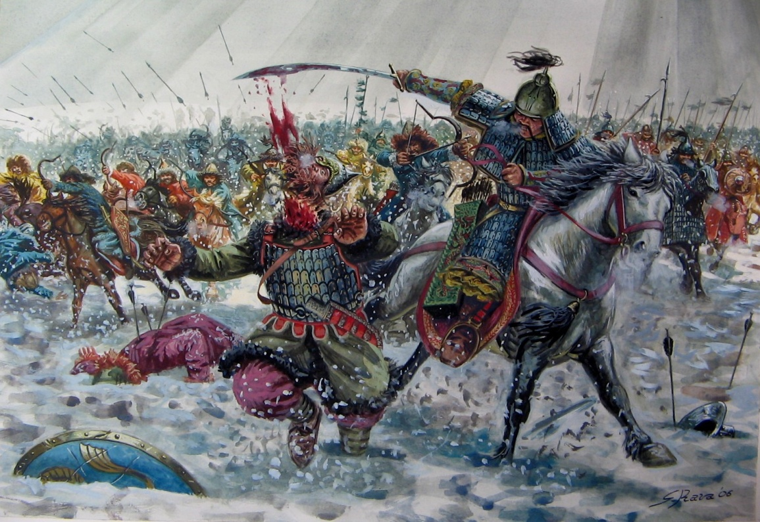
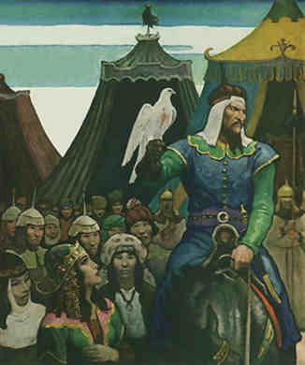
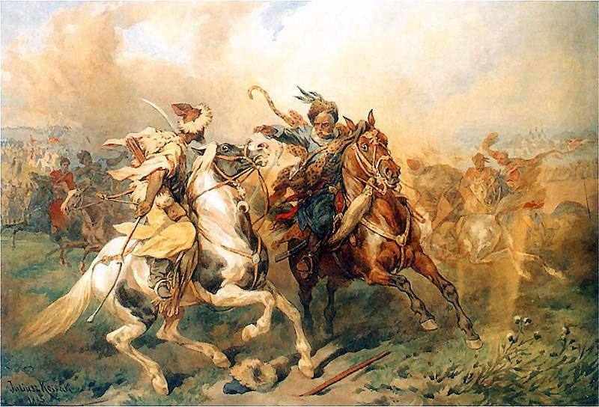

Slide 7
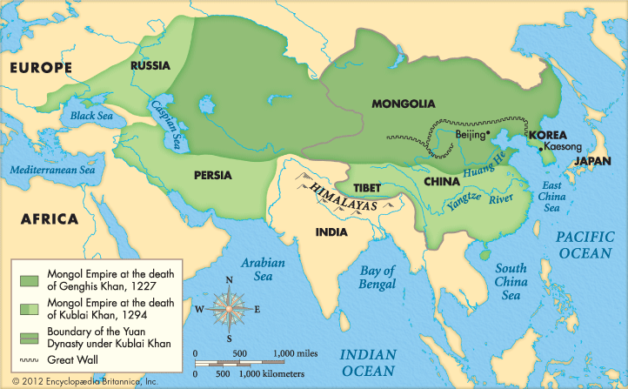

Slide 8
III. Governing Style
Local lords had to satisfy Mongol Emperors
Heavy tribute
Acknowledgement of higher rule
Tolerance: acceptance of a people’s culture
Conquered peoples were allowed to keep their culture
Governing style
Economy
Social structure

Slide 9
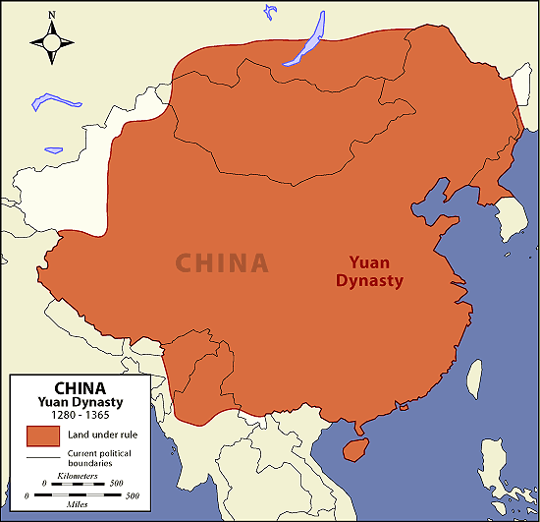
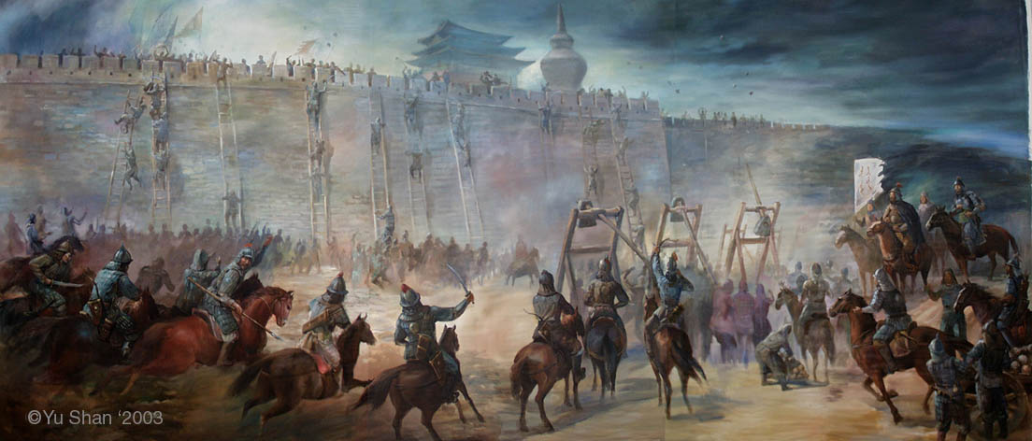
IV. Yuan Dynasty
One of the “Chinese” Dynasties, ruled by Mongols
Kublai Khan adopted the Chinese name of the Yuan for his dynasty
Did not want the Mongols to become involved with Chinese civilization.
However, Khan gave his best government jobs to Mongol workers and only allowed Mongols to serve in the army.
Chinese officials still governed the provinces.
Ming Dynasty would regain China in 1368 and revive Chinese culture and tradition

Slide 10
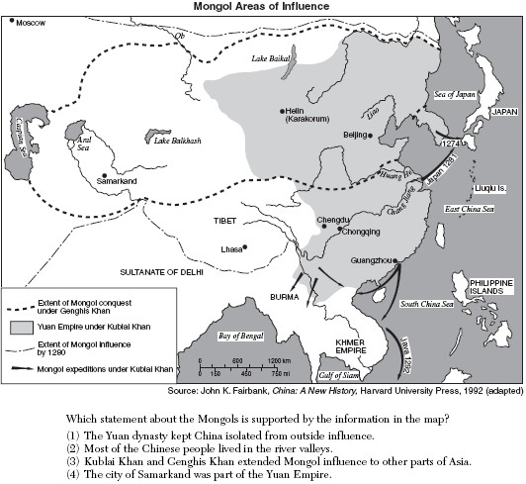

Slide 11
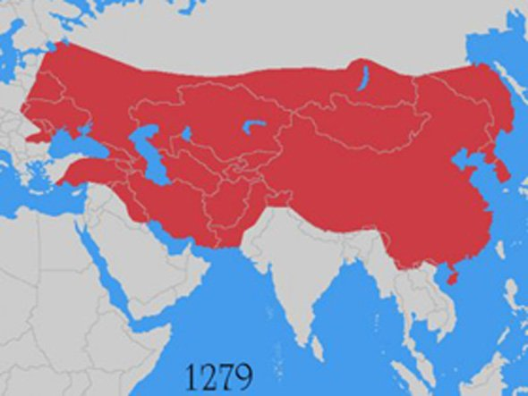
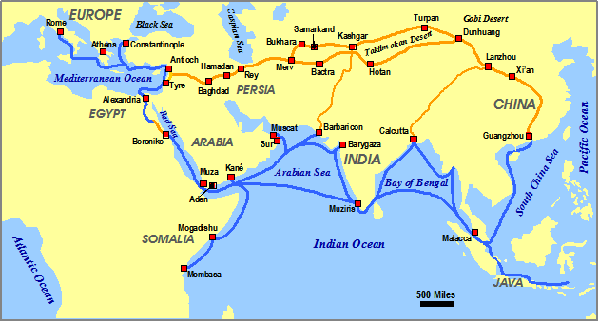
V. Pax Mongolia
Reached it’s greatest extent in 1300.
Stretched into Russia, Europe, Asia, and China
Destruction and Conquest
Most of the leaders ruled with tolerance.
Genghis Khan allowed art and education in his conquered countries.
They ruled Russia for 250 years.
Russia was cut off from the rest of Europe.
The Mongol influence led to increases in trade and cultural spread over Asia and Europe (safe passage along Silk Road)

Slide 12
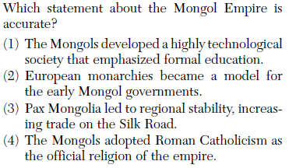

Slide 13
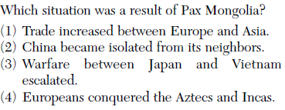

Slide 14
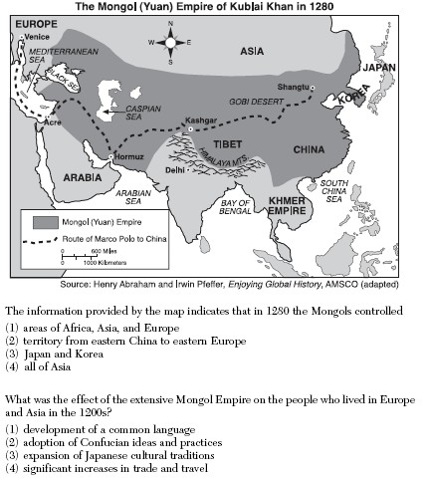

Slide 15
http://www.youtube.com/watch?v=szxPar0BcMo

Slide 16
Essential Question
How did the Mongolian Empire promote global connections and cultural diffusion?
Homework

