Slide 1
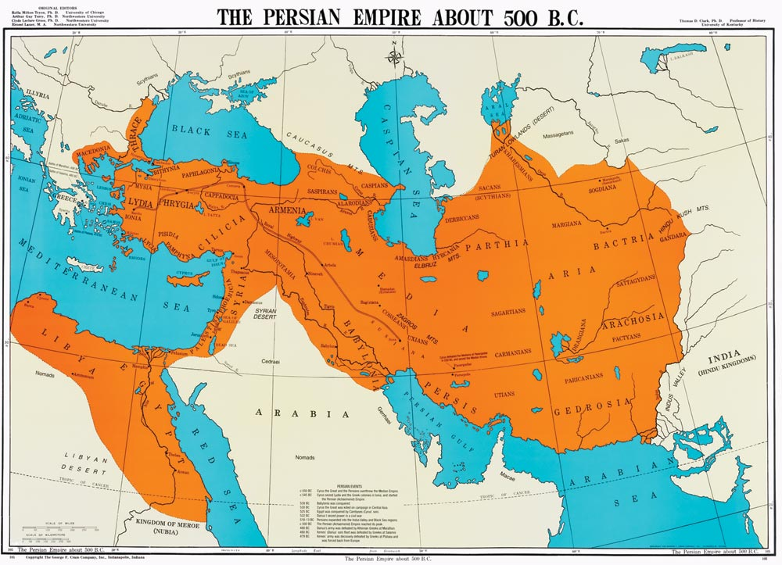
The Persian Empire
Global History and Geography I
Mr. Cox

Slide 2
Bellringer
Look at the maps in the classroom or in your book. Where is the country of Persia located today?
Essential Question
Why was the Persian Empire able to successfully control so much territory?

Slide 3
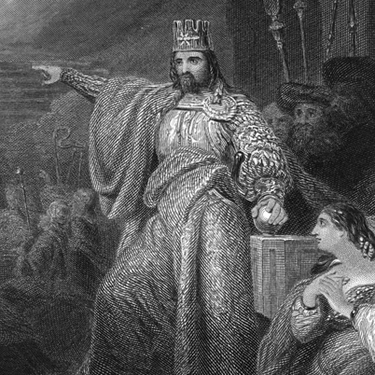
I. The Fall of Babylon
Invasions from foreign empires.
Persian Empire under Cyrus took over Babylon in 539 BCE

Slide 4
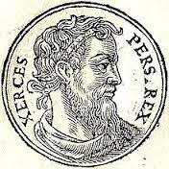
II. Persian Expansion
King Darius expanded the empire.
Stretched from Asia Minor to the Indian Subcontinent.
Established infrastructure
Had a set of laws for the whole empire.
Later on, Xerces would try to expand the empire into Europe. Fell to the Greeks.

Slide 5
III. Recipe for Success
Persian Kings practiced tolerance: acceptance of other’s cultures and beliefs
Established provinces headed by satraps: Persian generals who governed the territory.

Slide 6
Quickwrite
How would a policy of tolerance be an effective ruling strategy compared to oppression?

Slide 7
III. Recipe for Success Cont’d
Transitioned from a barter economy to a money economy throughout the empire
Barter: exchanging of goods for other goods
Money: exchanging of goods for currency

Slide 8
Essential Question
Why was the Persian Empire able to successfully control so much territory?
https://www.youtube.com/watch?v=wcTnjj1dtd0

