Slide 1
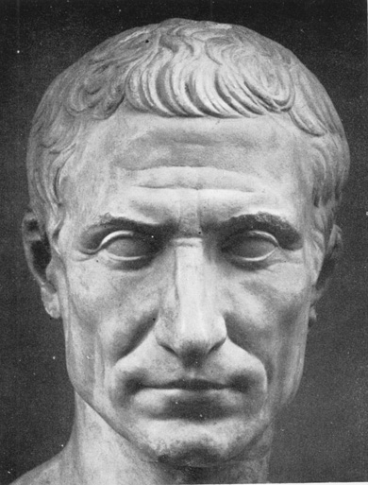
The Roman Empire
Global History and Geography I
Mr. Cox

Slide 2
Bellringer
Of the civilizations we have studied, why have they expanded their territory?
Essential Question
How did the Roman republic become an Empire?

Slide 3
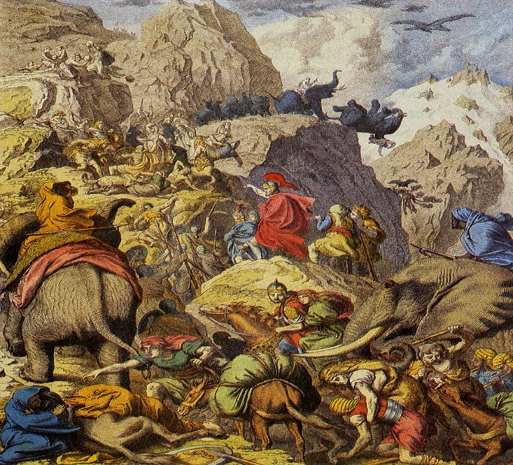
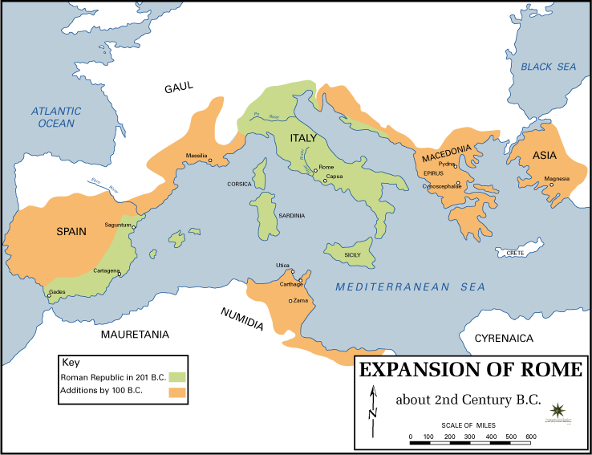
I. Expansion
Imperialism: establishing control over foreign lands
Punic Wars
Wars with Carthage
Rome won, defeated Hannibal
Roman Provinces emerged across the Mediterranean
Sections of territory controlled
Greece, Asia Minor, North Africa, Southern Europe
Created divisions within the Republic

Slide 4
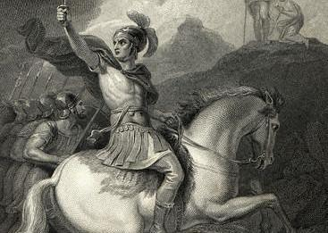
II. Julius Caesar
Internal problems sparked violence
Land ownership and class issues
Military General, Caesar brings his army to Rome and seizes control.
Maintained Roman institutions, but was able to pass many reforms for the people.

Slide 5
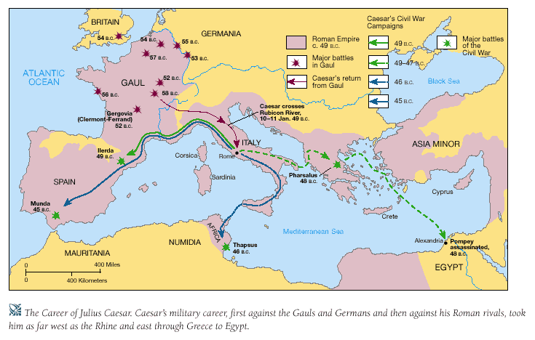
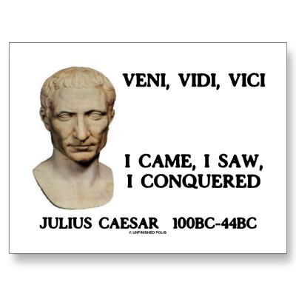

Slide 6
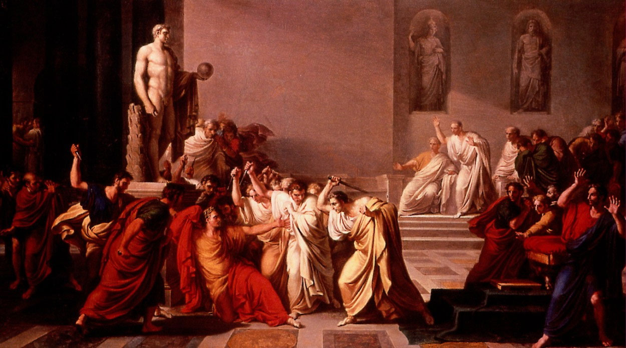
Maintained Roman institutions, but was able to pass many reforms for the people.
Assassinated by his friends and supporters in the Senate

Slide 7
III. Octavian and the Empire
Octavian (Augustus)
Julius’ grandson
Fought with Mark Antony (chief general) and ally of Cleopatra of Egypt for control of Rome
Passed many reforms as Emperor for the benefit of Roman people
No formal means of succession
http://www.youtube.com/watch?v=oPf27gAup9U

Slide 8
Essential Question
How did the Roman republic become an Empire?
Homework

