Slide 1
The Scientific Revolution
Global History and Geography I
Mr. Cox

Slide 2
Bellringer
Choose a notable historical figure and explain why this person is notable.
Essential Question
How did the Renaissance spread from Italy to the rest of Europe?

Slide 3
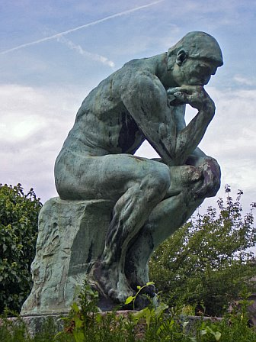
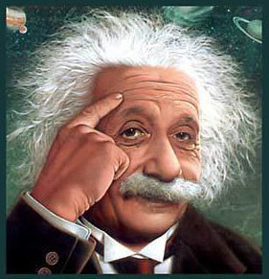
Setting the Stage…
Before 1500, many scholars decided what was true or false by referring to ancient Greek or Roman ideas that were held to be true.
Also, scholars simply turned to the Bible and religion when trying to answer difficult questions regarding the world around us.
The Renaissance created a rebirth of learning and art which inspired scholars to question ancient ideas that were accepted for centuries.
The religious movement known as the “Reformation”, caused followers to question accepted ways of thinking about god, salvation, and their answers to scientific problems.

Slide 4
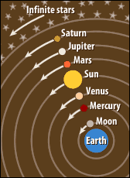
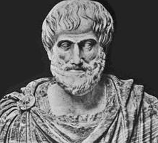
The Roots of Modern Science
The Medieval View- During the Middle Ages, most scholars believed the earth was an immovable object located at the center of the universe. This theory became known as the…..
Geocentric Theory- According to this belief, the sun, the moon, and the planets all moved in a circular path around the earth.
This idea came from Aristotle, the Greek philosopher of the 4th century BC.
Christianity taught that “god deliberately place the earth at the center of the universe”
Aristotle:
384-323 BC
“It is the mark of an educated mind to be able to entertain a thought without accepting it.” - Aristotle

Slide 5
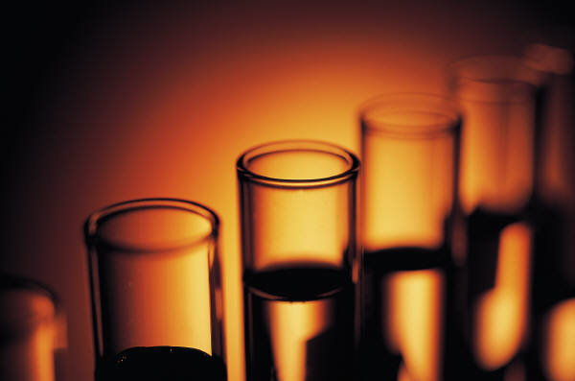
‘New way of thinking’
Beginning in the mid-1500’s, there was a group of scholars that published academic works which challenged the ideas of the church and ancient thinkers.
These thinkers replaced old assumptions with new theories.
In turn, they launched a change in European thought known as…
The Scientific Revolution- A new way of thinking about the natural world based on careful observation and willingness to question accepted belief.
“Doubt is the father of invention.”
– Galileo

Slide 6
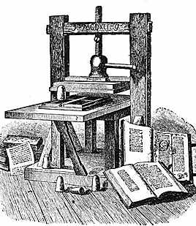
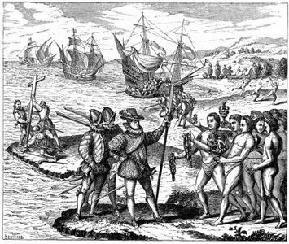
The Scientific Revolution
A combination of important events and discoveries that lead to the Scientific Revolution and helped spread its impact:
During the Renaissance, European explorations to Africa, Asia, and the Americas led to the discovery of indigenous peoples and animals that Europe had never seen.
The invention of the printing press during this time period helped to spread new and challenging ideas widely among European thinkers.
Johannes Gutenberg’s Printing Press
The Age of Exploration fueled scientific research in astronomy and mathematics because navigators needed better instruments and geographic measurement to determine their location at sea.

Slide 7
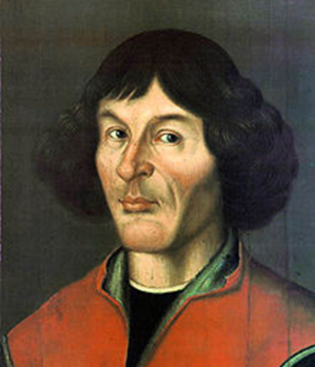
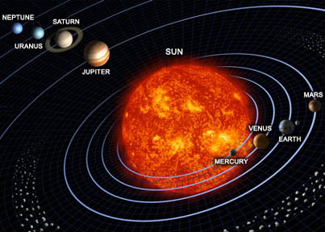
A Revolutionary Model of the Universe
Nicholaus Copernicus- A Polish astronomer who was the first to challenge Aristotle’s previous idea that the earth was the center of the universe. In the early 1500’s, after studying planetary movement for over 25 years, Copernicus reasoned that the earth and other planets revolved around the sun.
Knowing that fellow scholars and religious figures would reject and ridicule his idea, he didn’t publish his findings until the last year of his life in 1543, in a book called “On the Revolutions of the Heavenly Bodies”.
The Heliocentric Theory- or the “sun- centered” theory states that the earth and other planets revolve around the sun, rather than the sun revolving around the earth.

Slide 8
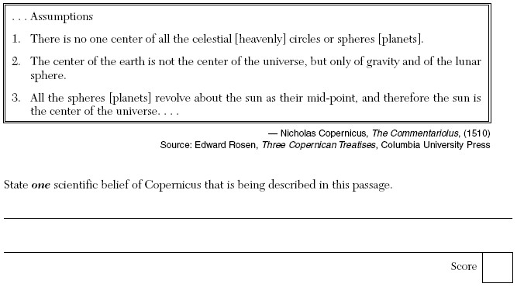

Slide 9
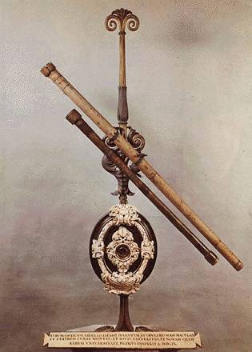
Building on Copernicus’s Theory
Over the next 150 years it would take the efforts of astronomer Tycho Brahe, mathematician Johannes Kepler, and mathematician/scientist Galileo Galilei to prove Copernicus’s “Heliocentric Theory” correct.
Galileo Galilei- Known as the “Father of Science”, he was an Italian scholar who built off of Copernicus’s, Kepler’s, and Brahe’s theories about our universe.
After learning about a Dutch lens-maker who built an instrument to enlarge far-off objects, Galileo built the 1st telescope in 1609 to study the heavens.
“Mathematics is the language in which God has written the universe.”
-Galileo

Slide 10
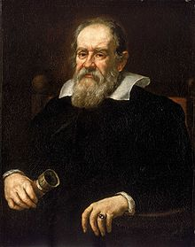
Galileo’s Discovery
http://www.youtube.com/watch?v=M7A-cJGlDgA&feature=related
In 1610, with the help and validation of his revolutionary telescope, Galileo published a book of his findings called “Starry Messenger”.
In this book he claimed that; Jupiter had 4 moons, the earths moon had a rough uneven surface, and the sun was the center of our universe.
Galileo’s discoveries frightened both the Catholic and Protestant leaders because it denounced church teaching and its overall authority.
“Facts which at first seem improbable will, even on scant explanation, drop the cloak which has hidden them and stand forth in naked and simple beauty.”
– Galileo

Slide 11
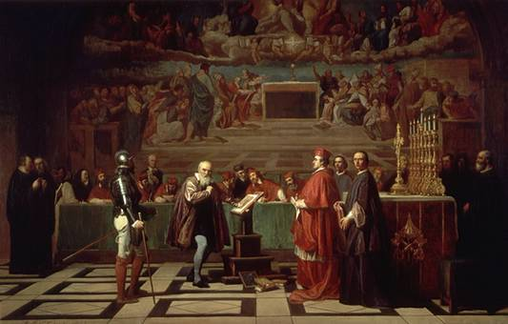
Conflict with the Church
http://www.youtube.com/watch?v=M7A-cJGlDgA&feature=related
In 1616, the Catholic church warned Galileo not to defend the theories of Copernicus, but in 1632, he published “Dialogue Concerning the Two Chief World Systems,” which compares the Heliocentric and Geocentric theories. Galileo clearly backs up Copernicus’s findings.
Enraged, the Pope summoned him to trial in 1633, where he was threatened with torture until he agreed to read and sign a confession against his discoveries and proclaiming Copernicus to be false.
Galileo live out the rest of his life on house arrest in his villa near Florence, Italy and died in 1642.
“Facts which at first seem improbable will, even on scant explanation, drop the cloak which has hidden them and stand forth in naked and simple beauty.”
– Galileo

Slide 12
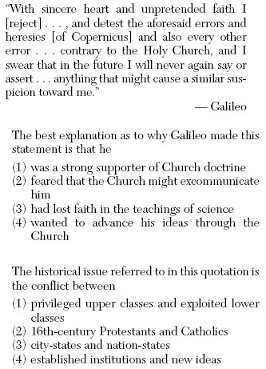

Slide 13
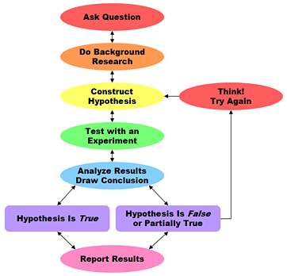
The Scientific Method
The revolution in scientific thinking that Copernicus, Kepler, and Galileo began, eventually led to a new approach in science called the scientific method.
Scientific Method- This is the logical procedure for gathering information through observations and experiments in order to test ideas that are in question.
The work of two important thinkers of the 1600’s, Francis Bacon & Rene’ Descartes, helped to advance this new approach to scientific discovery.
“If I have ever made any valuable discoveries, it has been owing more to patient attention, than any other talent” – Sir Isaac Newton

Slide 14
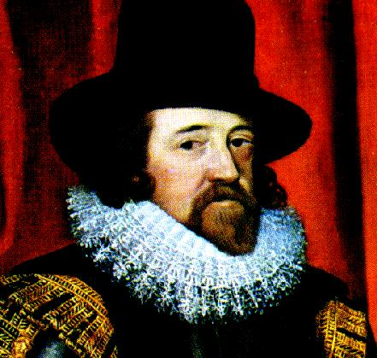
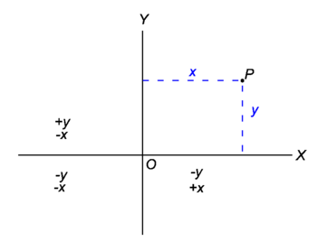
Bacon & Descartes
Francis Bacon- English Statesman and writer who believed that a better scientific understanding of the world would generate practical knowledge to improve peoples live.
Bacon criticized medieval scholars for relying on the conclusions of Aristotle and other ancient thinkers and urged scientists to challenge old theories with experiments and new conclusions.
Rene’ Descartes- French mathematician who developed analytical geometry which combined algebra and geometry. This new form of math served as an important new tool for scientific research.
Descartes also criticized medieval scholars like Bacon, but believed that rather then using experiments, scientists need to rely on mathematics and logic in order to prove fact by reason.
Cartesian Plain
“If a man will begin with certainties, he shall end in doubts; but if he will be content to begin with doubts he shall end in certainties.” – Francis Bacon

Slide 15
Newton’s Law of Gravity
http://www.youtube.com/watch?v=danYFxGnFxQ
Sir Isaac Newton- An English scientist who discovered that the same force ruled motion of the of the planets and all matter on earth and in space.
The key idea that linked motion in the heavens with motion on the earth was the law of universal gravitation.
Gravity- according to this law, every object in the universe attracts every other object. The amount of attraction depends on the weight of the objects and their distance from one another.
In 1687, Newton published his ideas in a work called, “The Mathematical Principles of Natural Philosophy”
This book is known as one of the most important science books ever written.
http://www.youtube.com/watch?v=hZi8TXtRRYg
“For every action there is always opposed an equal reaction.”
- Sir Isaac Newton

Slide 16
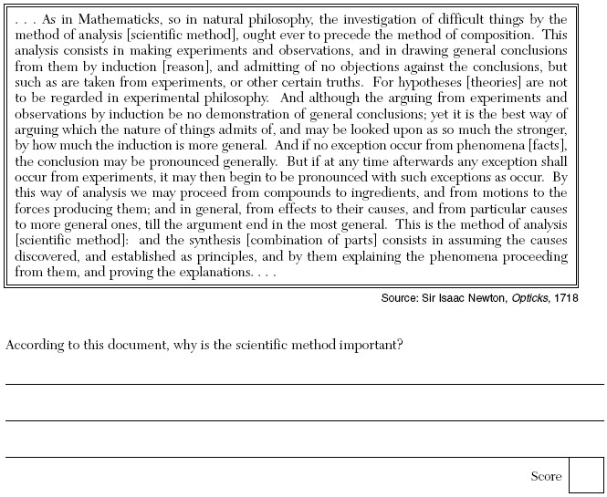

Slide 17
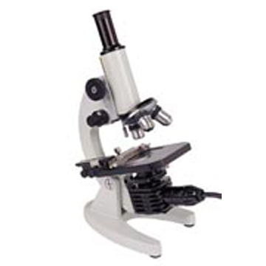
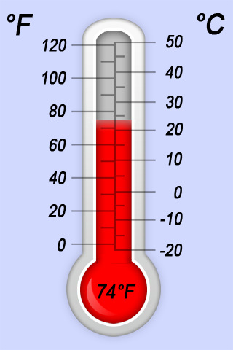
Scientific Revolution Spreads
Scientific Instruments- Scientists developed new tools and instruments to make precise observations that the Scientific Method needed.
The Microscope- Invented by a Dutch eye glass maker, Zacharias Janssen, in 1590.
Barometer- In 1643, one of Galileo’s students, Evangelista Torricelli, developed the 1st instrument for measuring atmospheric pressure and predicting weather patterns.
Thermometer- In 1714, the German physicist, Gabrielle Fahrenheit, made the 1st thermometer to use mercury in glass and showed water freezing at 32 degrees.
Anders Celsius- This Swedish astronomer, created a separate scale for the mercury thermometer in 1742, showing freezing at 0 degrees.
“To me there has never been a higher source of earthly honor or distinction than that connected with advances in science.” – Sir Isaac Newton

Slide 18
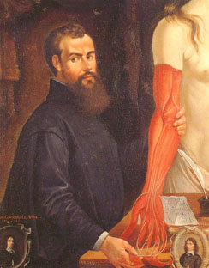
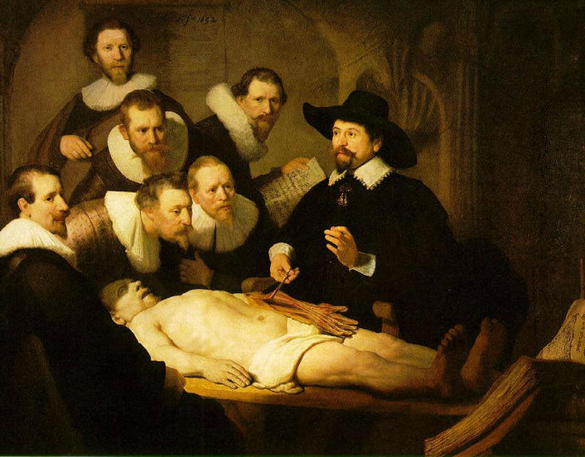
Scientific Revolution Spreads
Medicine & the Human Body- During the Middle Ages, European Doctors had accepted as fact the writings of an ancient Greek physician named Galen. Galen had never dissected a human body and instead studied the anatomy of pigs and other animals.
Andreas Vesalius- Dutch doctor who proved Galen’s assumptions wrong by dissecting human corpses and publishing his observations in 1543, in a book called; “On The Structure of the Human Body.”
This book included detailed drawings of human organs, bones, and muscle.
Edward Jenner- British Physician in the late 1700’s who introduced a vaccine to prevent the extremely deadly and contagious small pox disease.
Andreas Vesalius
1514-1564

Slide 19
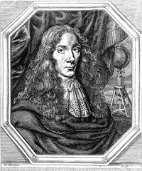
Discoveries In Chemistry
Robert Boyle- Pioneered the use of the Scientific Method in chemistry and is considered the founder of modern chemistry.
In a book called “The Sceptical Chymist”, written in 1661, Boyle challenged Aristotle’s idea that the earth consisted of four elements: earth, wind, fire, and water.
Instead, Boyle proposed that matter was made up of smaller primary particles that joined together in different ways. This theory eventually led to the development of….
Boyles Law- This law explains how volume, temperature, and pressure of gas affect each other.

Slide 20
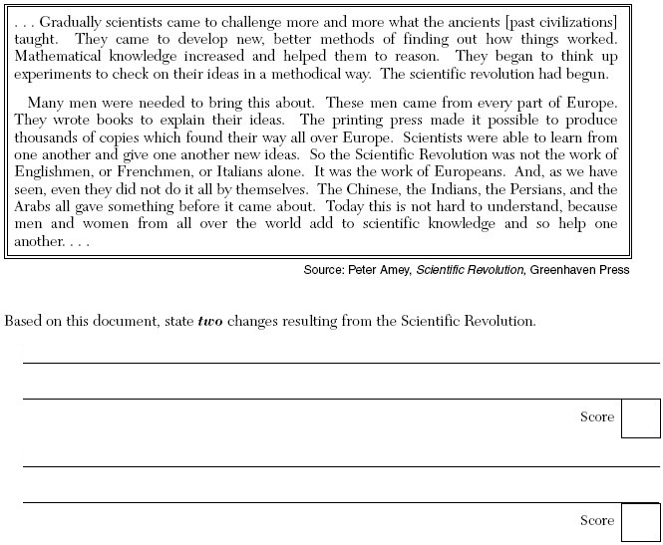

Slide 21
Essential Question
How did the Scientific Revolution challenge many traditional beliefs in Europe?
Page 359, 3-5
Homework

