Slide 1
The Social Sciences
Global History and Geography I

Slide 2
Bellringer
What are two conclusions that you can draw and two errors that you can identify from the following graph?
Essential Question
Why is it important to be able to read and understand charts in Social Studies?

Slide 4
Bellringer
What are two conclusions that you can draw and two errors that you can identify from the following graph?
Essential Question
Why is it important to be able to read and understand charts in Social Studies?

Slide 5
I. The Social Sciences

Slide 6
I. The Social Sciences
Field of study concerned with society and the relationships among individuals within a society.
History

Slide 7
I. The Social Sciences
Field of study concerned with society and the relationships among individuals within a society.
History
Geography

Slide 8
I. The Social Sciences
Field of study concerned with society and the relationships among individuals within a society.
History
Geography
Political Science

Slide 9
I. The Social Sciences
Field of study concerned with society and the relationships among individuals within a society.
History
Geography
Political Science
Economics

Slide 10
I. The Social Sciences
Field of study concerned with society and the relationships among individuals within a society.
History
Geography
Political Science
Economics
Anthropology/Archeology

Slide 11
I. The Social Sciences
Field of study concerned with society and the relationships among individuals within a society.
History
Geography
Political Science
Economics
Anthropology/Archeology
These different social sciences are all unique yet very interrelated/connected

Slide 12
II. Anthropology

Slide 13
II. Anthropology
The study of human origins, developments, and societies.

Slide 14
II. Anthropology
The study of human origins, developments, and societies.
Many fields of specialization (cultural, biological, linguistics, etc.)

Slide 15
II. Anthropology
The study of human origins, developments, and societies.
Many fields of specialization (cultural, biological, linguistics, etc.)
Culture – the way of life of a society that is handed down from one generation to the next through learning and experience.

Slide 16
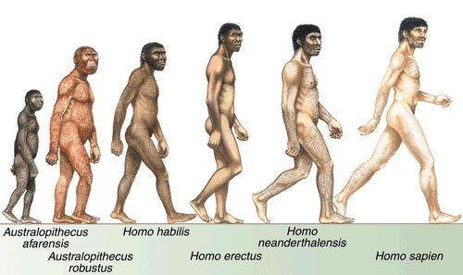

Slide 17
III. Archeology

Slide 18
III. Archeology
Specialized branch of Anthropology and Geography

Slide 19
III. Archeology
Specialized branch of Anthropology and Geography
Focus on the study of peoples past and ancient cultures.

Slide 20
III. Archeology
Specialized branch of Anthropology and Geography
Focus on the study of peoples past and ancient cultures.
Artifacts – objects made by people that have been recovered by Archeologists.

Slide 21
III. Archeology
Specialized branch of Anthropology and Geography
Focus on the study of peoples past and ancient cultures.
Artifacts – objects made by people that have been recovered by Archeologists.
Technology – the skills and tools people use to meet their basic needs. Technology has changed over time as culture has changed.

Slide 22
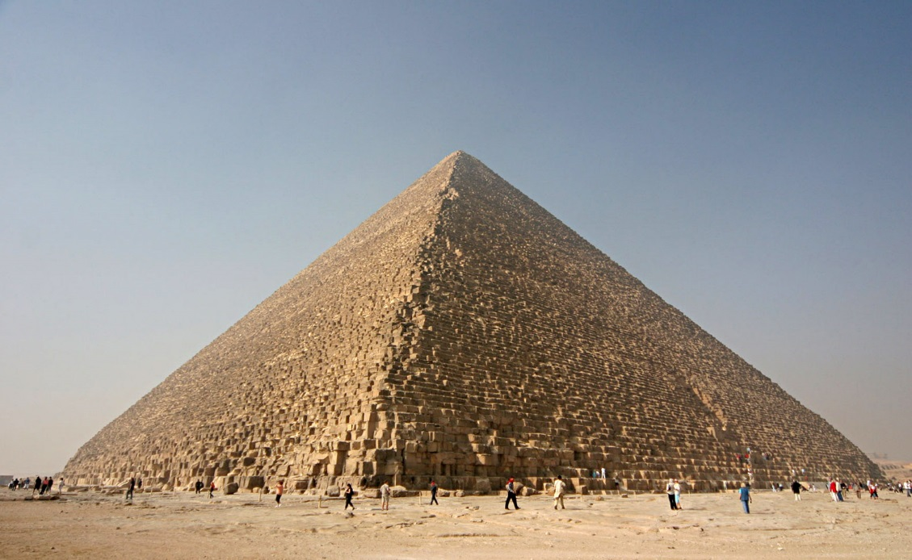
Technology changes over time!

Slide 23
IV. Economics
Economics: the study of how people seek to satisfy their needs and wants by making choices.
Need: item that is necessary for survival (air, shelter, food)
Want: item that is not necessary for survival (phone, car, etc)
Goods: physical objects that can be accumulated
Services: actions or activities that are performed for a person

Slide 24
V. History
Study of past people, places, events, etc
Primarily gain knowledge through research of primary and secondary sources
Primary Source: from the time period of study
Secondary Source: written after the time period
Must also be able to distinguish fact from opinion

Slide 25
V. History
Study of past people, places, events, etc
Primarily gain knowledge through research of primary and secondary sources
Primary Source: from the time period of study
Secondary Source: written after the time period
Must also be able to distinguish fact from opinion
VI. Political Science
The study of governments, public policies and political processes, systems, and political behavior.
How and why different governments emerge where and when they do
How governments treat people and change over time

Slide 27
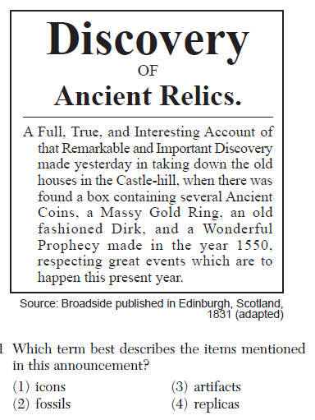

Slide 28
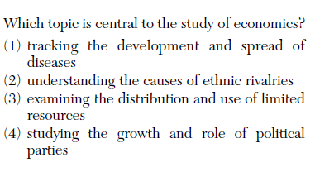

Slide 30
